Slide 1


Test Results of the First Short Coil for the LHC Inner Triplet Upgrade &
Short Quadrupole Assembly Test
G. Ambrosio (FNAL)
on behalf of the MQXF team:
M. Anerella, G. Apollinari, R. Bossert, R. Carcagno, D. Cheng, G. Chlachidze,
D. Dietderich, H. Felice, P. Ferracin, A. Ghosh, R. Hafalia, E. Holik, S. Izquierdo Bermudez, M. Juchno, S. Krave, F. Lewis, M. Marchevsky, V. Marinozzi, F. Nobrega, I. Novitski, D. Orris, H. Pan, J. C. Perez, I. Pong, S. Prestemon, L. Rossi, G.L. Sabbi,
C. Santini, J. Schmalzle, M. Sorbi, S. Stoynev, C. Sylvester, M. Tartaglia,
E. Todesco, G. Velev, P. Wanderer, M. Yu, A.V. Zlobin

Slide 2
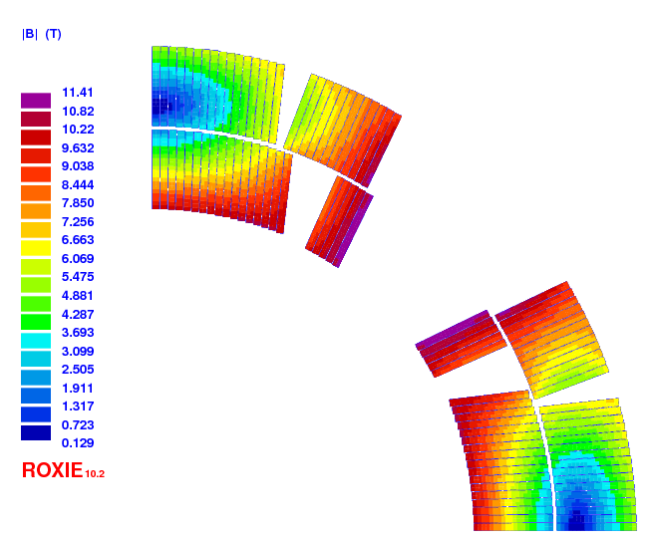
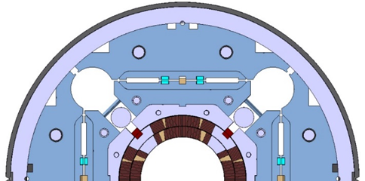
MQXF: LHC HiLumi Upgrade
US-LARP & CERN
LHC Inner Triplet Hi-Lumi Upgrade
 | Unit | Value
Aperture | mm | 150
Nominal gradient | T/m | 132.6
Operating temperature | K | 1.9
Operating current | kA | 16.5
Peak field at op. current | T | 11.4
Stored energy/length | MJ/m | 1.17
Peak field including strand self field
Courtesy of S. Izquierdo Bermudez
Courtesy of P. Ferracin
P. Ferracin, et al. “Development of MQXF, the Nb3Sn Low-β Quadrupole for the HiLumi LHC” this session

Slide 3
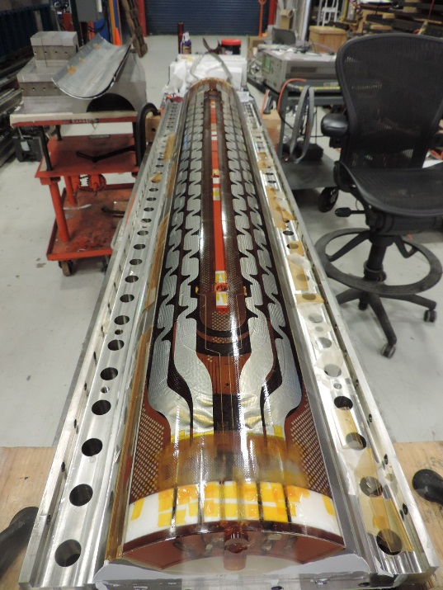
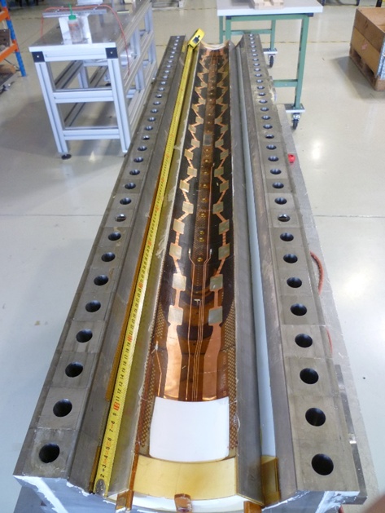
Nb₃Sn Coils
1st generation short coils (LARP/CERN):
  Practice-test coils: 2/2
  OST RRP coils: 4/3
  Bruker-EAS PIT coils: -/2 in progress
1st generation long coils (LARP):
  Practice: 1 in progress
  OST RRP coils: 2 in progress
2nd generation short coils:
  Starting both at LARP & CERN
Courtesy of F. Nobrega
Courtesy of J. C. Perez
E. Holik, et al. “Fabrication and Analysis of 150 mm Aperture Nb3Sn MQXF Coils”, this session
S. Izquierdo Bermudez, et al. “Second Generation Coil Design of the Nb3Sn low β quads for HL-LHC”, 2POBA02

Slide 4
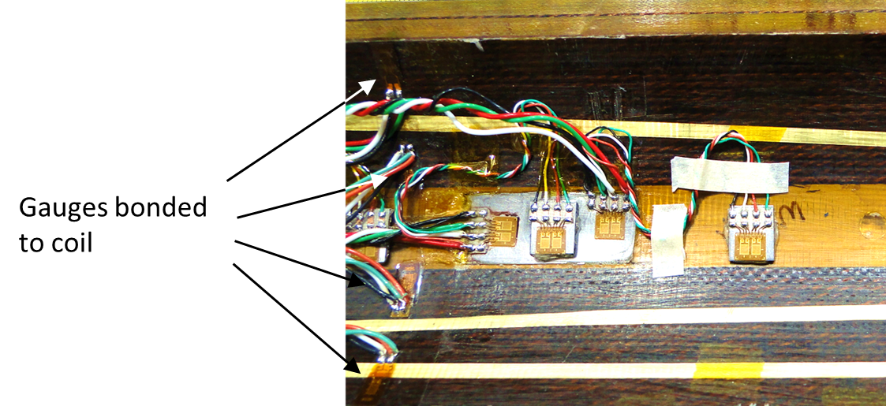
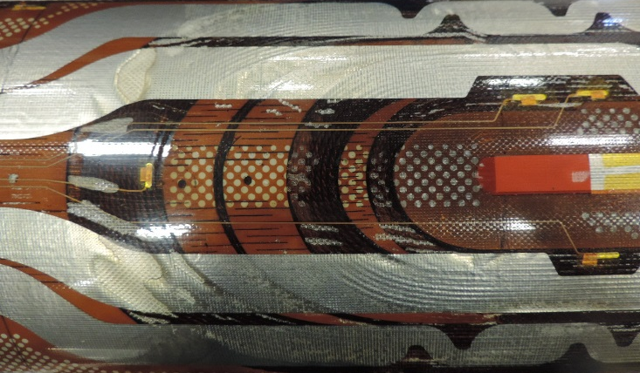
LARP coil QXFS2 from practice to test coil
Strand diameter, mm |  | 0.85
Strand composition |  | (Nb -7.5 w% Ta)₃Sn
Strand type |  | OST-RRP 108/127
Cable width, mm |  | 18.09
Cable mid. thickness, mm |  | 1.53
Keystone angle, degree |  | 0.52
Twistpitch, mm |  | 109
Number of strands |  | 40
Core (25 um x 11.8 mm) |  | 316 SS
Safe strain at RT
< 0.2%
based on strain cycling*
Strain gauge system:
1 azim. + 1 longit. full bridge on inner titanium pole,
4 quarter bridges bonded to inside surface of inner coil,
  used during construction only.
Small bubbles on lead end surface after impregnation
Courtesy of R. Bossert
*N. Cheggour, et al., “Influence of Ta and Ti doping on the irreversible strain limit of ternary Nb₃Sn superconducting wires made with restacked-rod process”, Supercond. Sci. and Tech., 20, (2010).

Slide 5
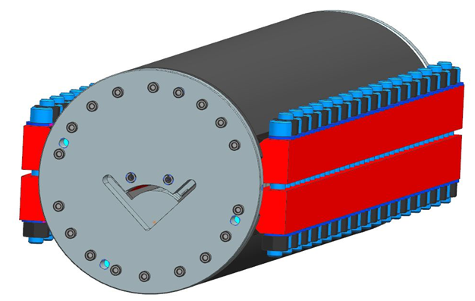
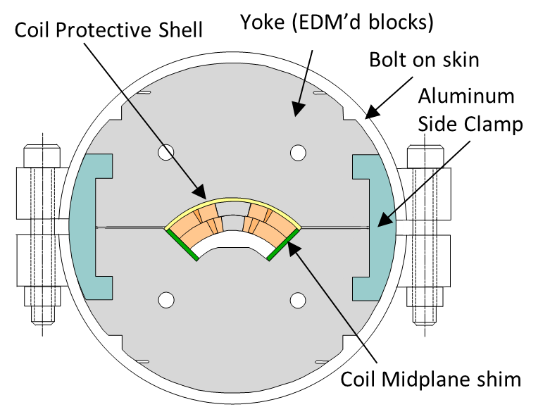
Single Coil Test Facility a.k.a “Mirror”
Courtesy of A. Zlobin, I. Novitski, R. Bossert
MQXFS Mirror Design is derived from previous Mirrors built at Fermilab by the HFM group
Short mirrors (<2m): bolted
Long mirrors (>2m): welded
MQXFS Mirror
SSL @ 1.9K:
68%
96%
97%
98%
SSL @ 1.9/2.2K:
77%
89%
94%
98%
TQ mirror
HQ mirror
HFM Dipole Mirror
A.V. Zlobin, et al. “Testing of a Single 11T Nb₃Sn Dipole Coil using a Magnetic Mirror Structure”,
IPAC’2014, Dresden, June 2014

Slide 6
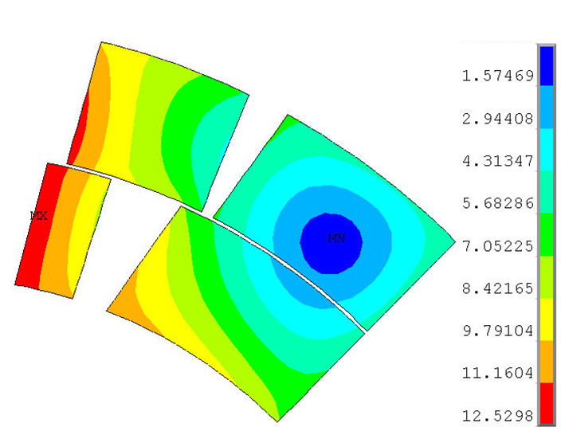
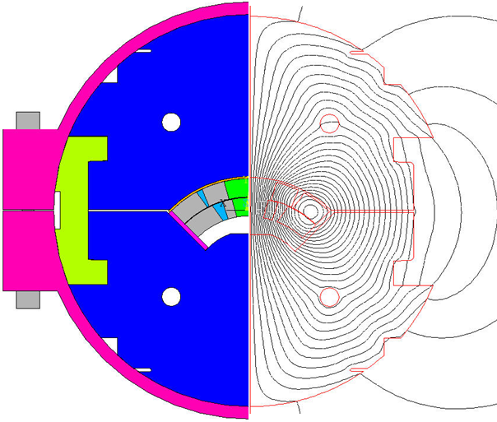
MQXFSM1 SSL
Mirror structure as coil test facility for QC:
  Load line within a few percent from MQXF load line
  Low prestress to avoid damage
T [K] | Bpeak_SS [T] | Icable_SS [A]
4.5 | 13.20 | 18734
1.9 | 14.49 | 21065
Courtesy of A. Ghosh, D. Dietderich, S. Izquierdo Bermudez

Slide 7
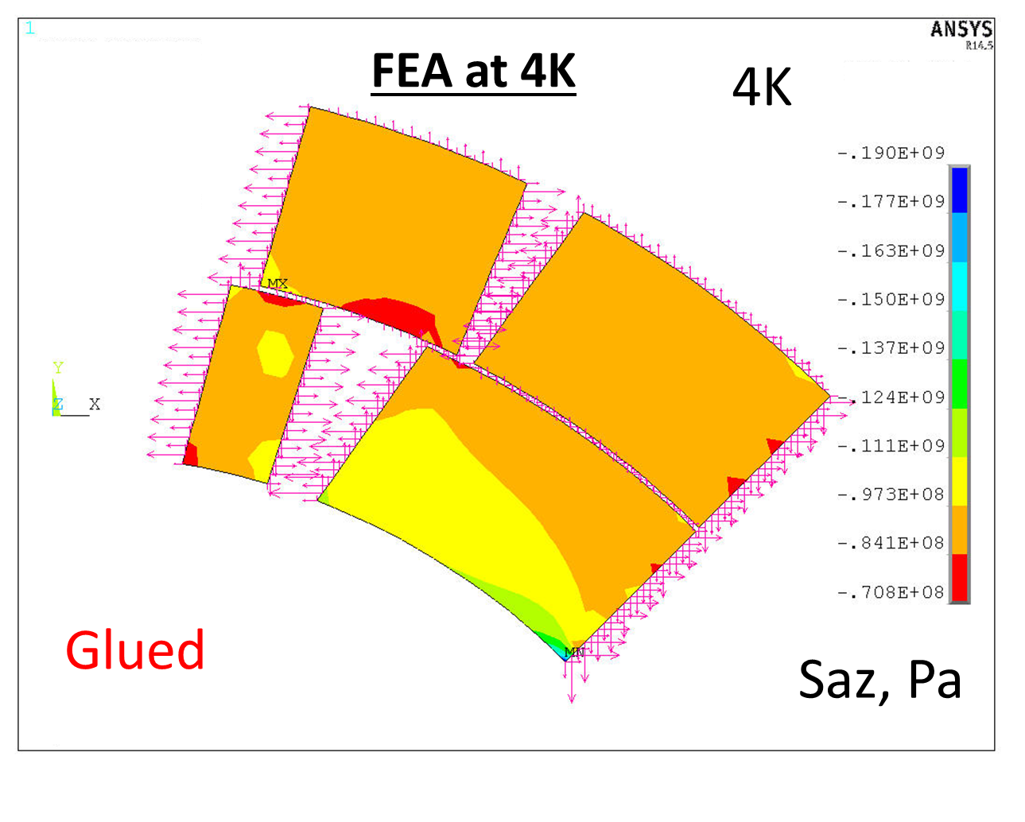
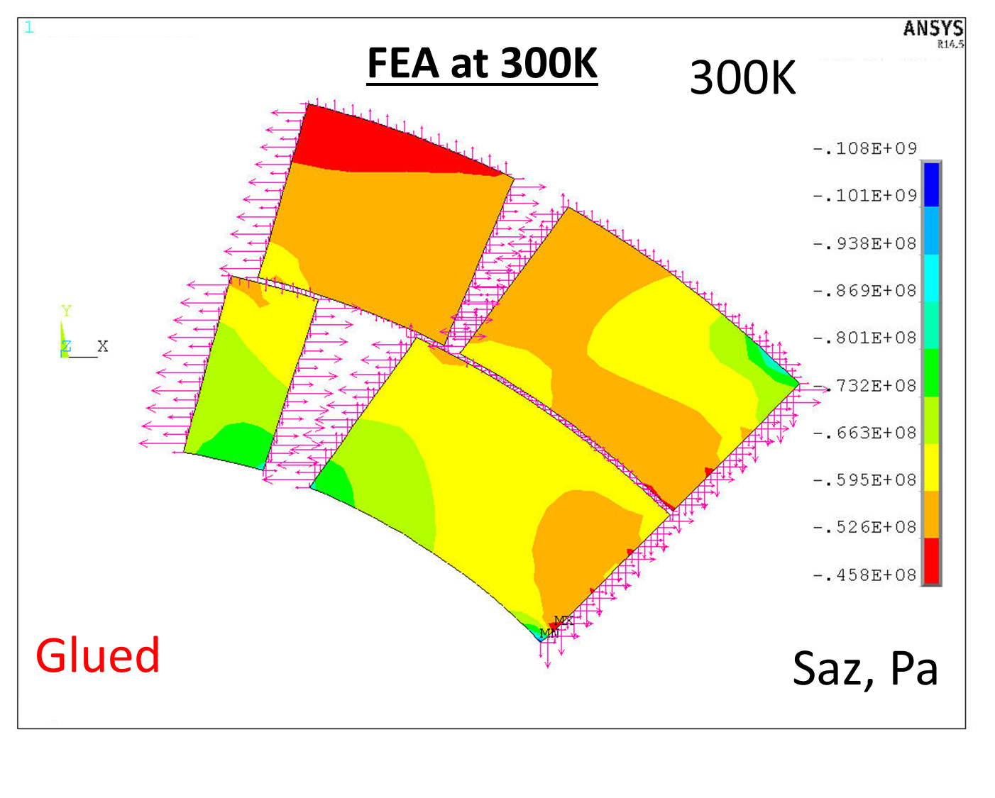
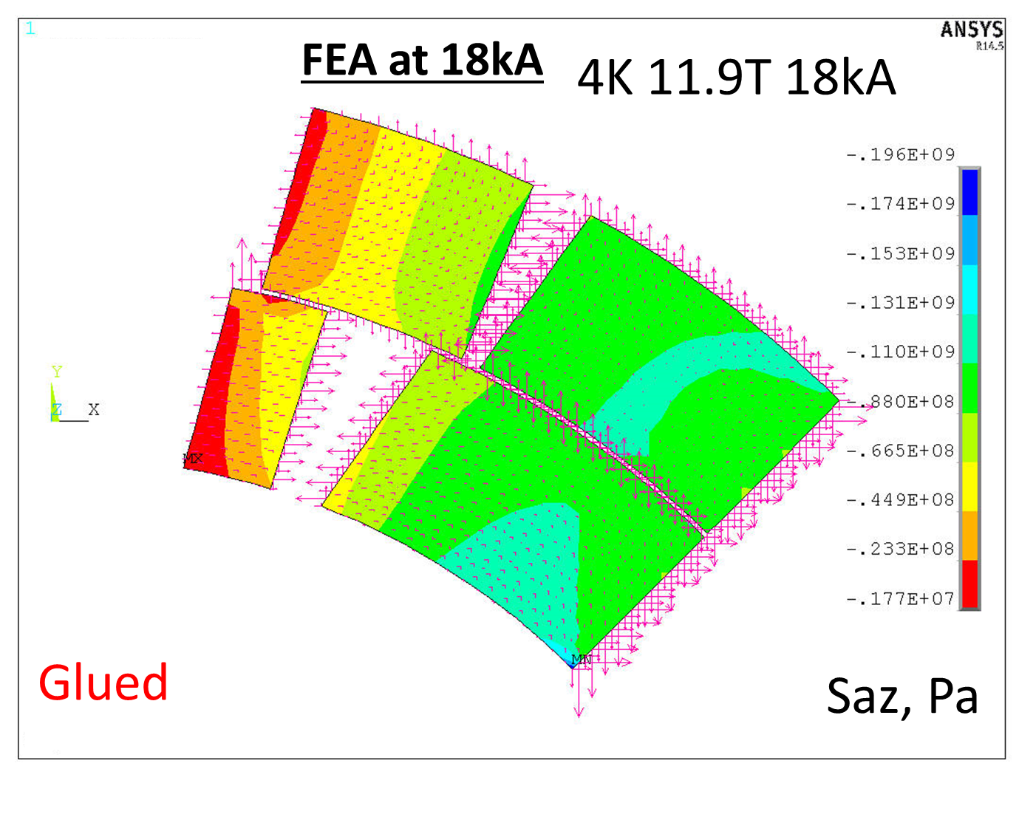
Pre-stress Target
Courtesy of I. Novitski and S. Krave
At quench current the azimuthal Lorentz force is ~30% lower than in the quadrupole model
=> lower coil prestress needed:
~80 MPa at 300K
< 140 MPa at 4.2K
< 150 MPa at 12T

Slide 8
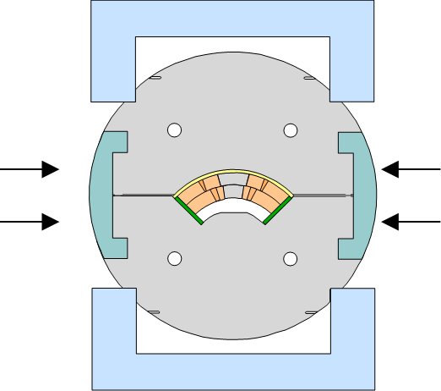
Actual Pre-Stress and Strain
Courtesy of R. Bossert
Press to 80 Mpa azimuthal stress in press without skin or clamps.
Actual – 79 MPa azimuthal
480 µS longitudinal
(increased at every loading)
Drive in side clamps, increasing azimuthal preload to 90 Mpa
Actual – 89 MPa azimuthal
530 µS longitudinal
Install skin, return to press, press to azimuthal preload of 90 MPa.
Actual – 89 MPa azimuthal
310 µS longitudinal
Bolt skin and release press. Final average azimuthal coil preload of 70 MPa.
Actual – 77 MPa azimuthal
270 µS longitudinal

Slide 9
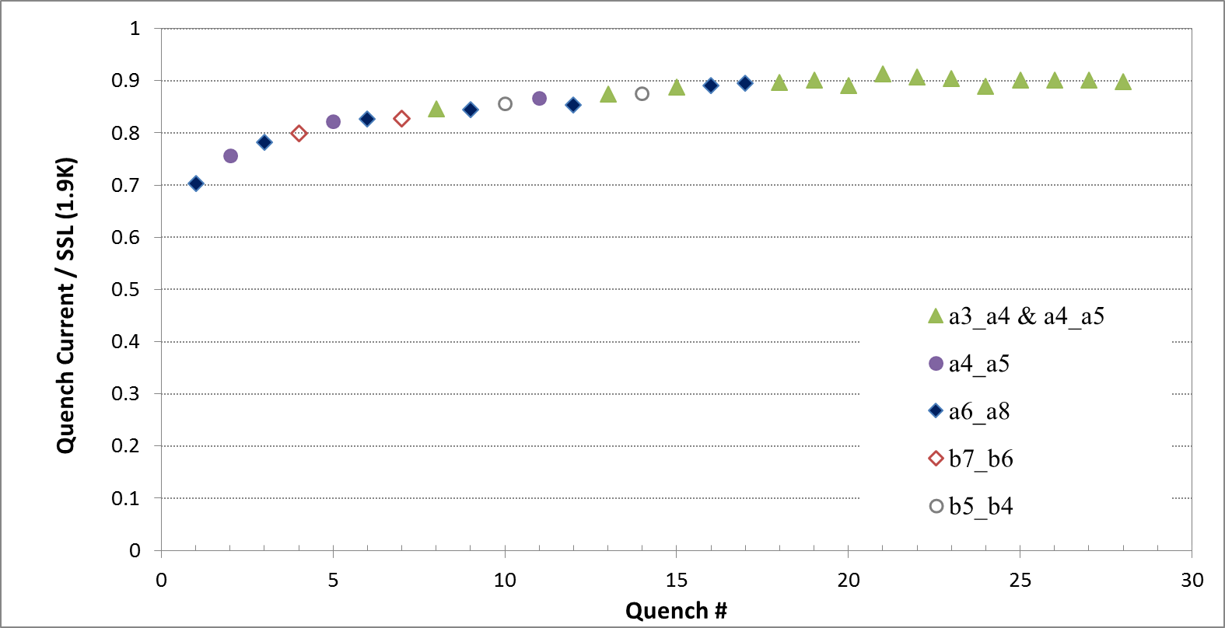
Quench Training (1.9K)
Courtesy of S. Stoynev
All quenches in pole turns (mostly in Inner Layer, a few in Outer Layer)
Limiting point: Inner Layer, Pole turn, Lead End (highest field region)
17.8 kA
84.5% SSL
19.2 kA, 91.3% SSL
16.5 kA
78.3% SSL

Slide 10
Ramp Rate & Temperature Dependence
Courtesy of S. Stoynev
Quench ramp rate dependence at 1.9 K:
Quench location as in training quenches
No quench in ramp down from
16.5 kA at 300 A/s
Temperature dependence study at 20 A/s
90% of SSL both at 1.9 K and 4.5 K
Holding current test:
No quench:
for 2 hours at 16.5 kA at 4.5 K
for 2 hours at 17.8 kA at 1.9 K

Slide 11
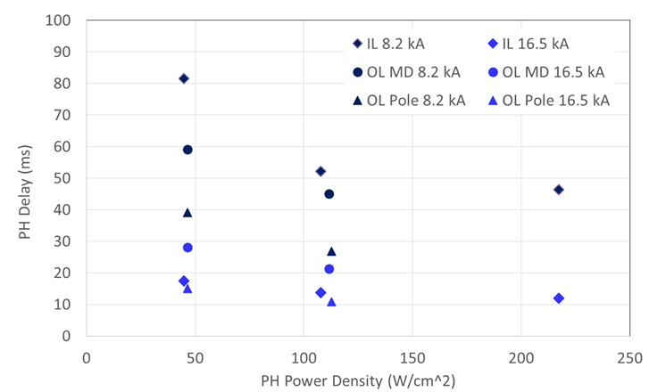
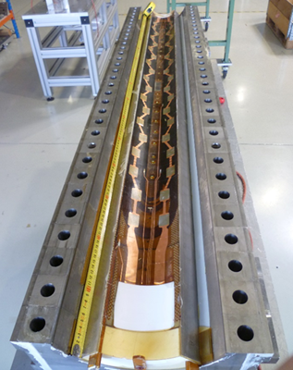
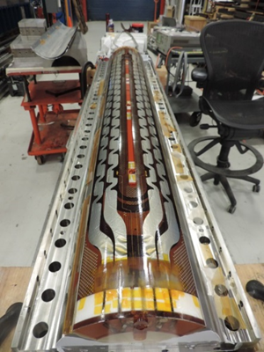
QP Studies and RRR
Courtesy of S. Stoynev
Inner Layer heaters copper plated
Outer Layer heaters with heating stations
Both heaters performed as expected (delay < 15 ms at 16.5 kA)
130 < RRR < 160 for all segments

Slide 12
MQXFSM1 Observations
Overall this coil performed well and 91% SSL is a good result for a new coil design
  Promising for the 1st short model test
Nonetheless there is some degradation
Possible explanations:
  Excessive strain during assembly for (Nb -7.5 w% Ta)₃Sn RRP strand
  Impregnation bubbles may have increased local strain
    Coil is presently spare for 1st MQXFS test
    Will be cut when no more needed

Slide 13
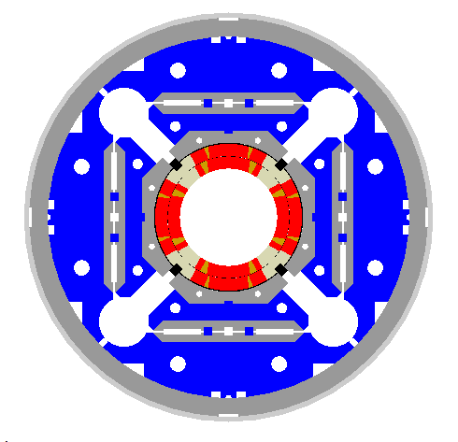
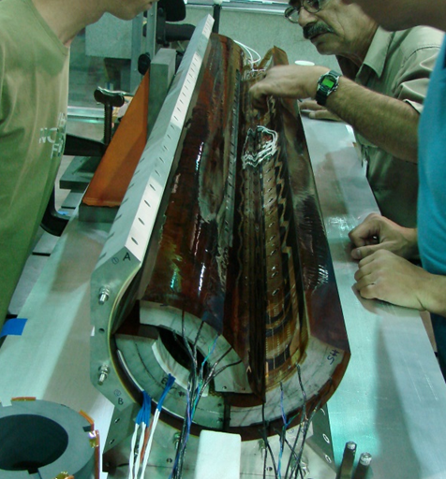
MQXFS Assembly Overview
Al shell
LHe SS vessel
Iron yoke
Cooling hole
Iron pad
Titanium pole
Alignment pin location
Coil
Iron masters
Welding strip slot
Load key
Alignment key location
Bladder location
Assembly alignment slots
Al bolted collar
Practicing assembly & loading with the first Nb₃Sn coils
  Five assemblies to get the final size of the collar shims & alignment key shims.
  Possible damage to some coils during a disassembly phase
  Lessons learned applied to subsequent and future assemblies/disassemblies
Courtesy of D. Cheng, H. Pan and H. Felice

Slide 14
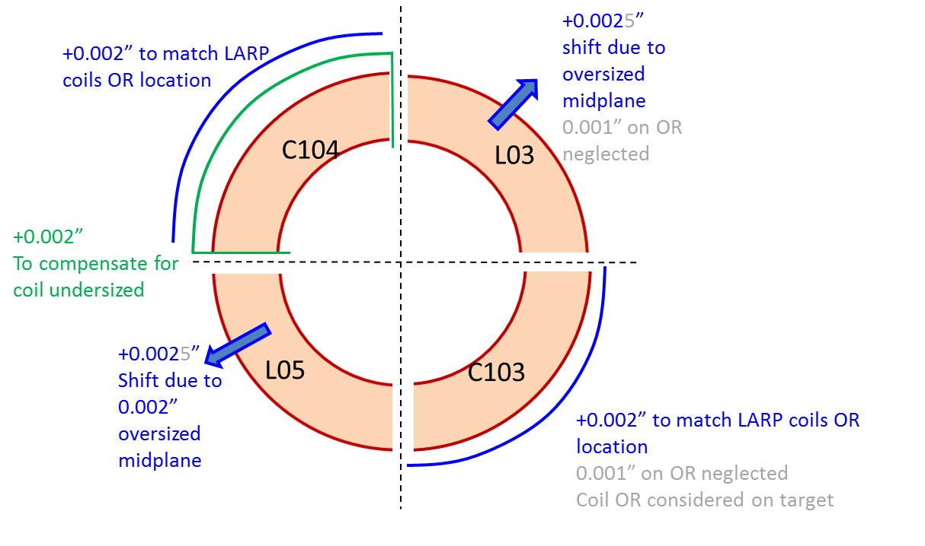
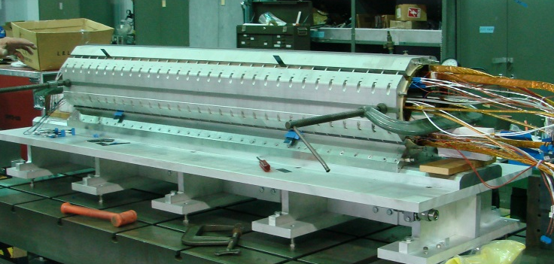
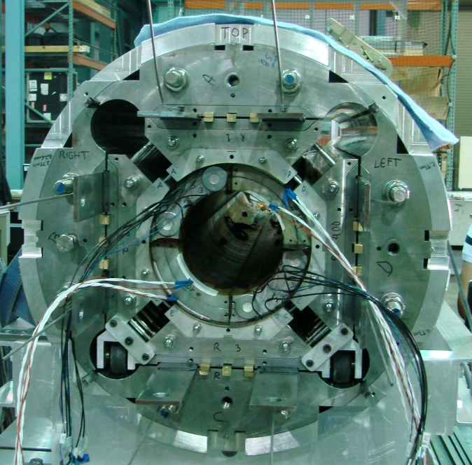
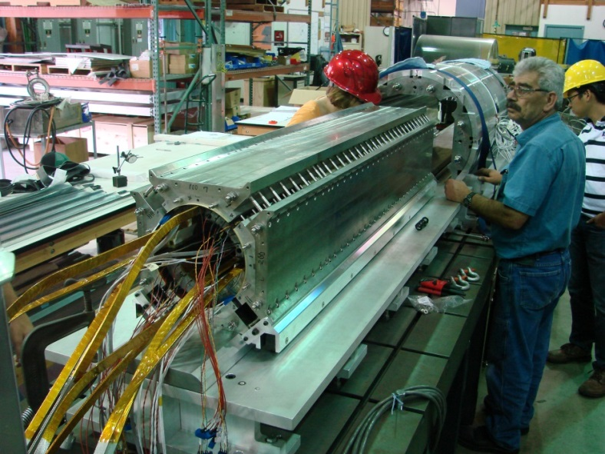
Assembly iterations
MQXFS magnet assembly iterations
No. | Radial Shim | Pole Key Shim | Pressure Sensitive Film
1 | 1.575 mm | 0 | Yes
2 | 1.524 mm | 0 | No
3 | 1.448 mm | 0 | Yes
4 | 1.448 mm | 0.43mm per side | No
5 | 1.448 mm | 0.46 mm per side | No
Collar pack assembly
Coil subassembly insertion
Bladders are in position
Courtesy of D. Cheng, H. Pan and H. Felice

Slide 15
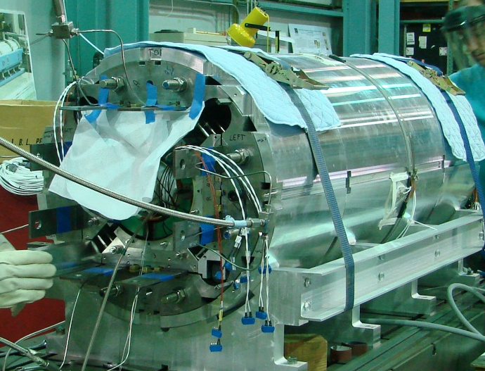
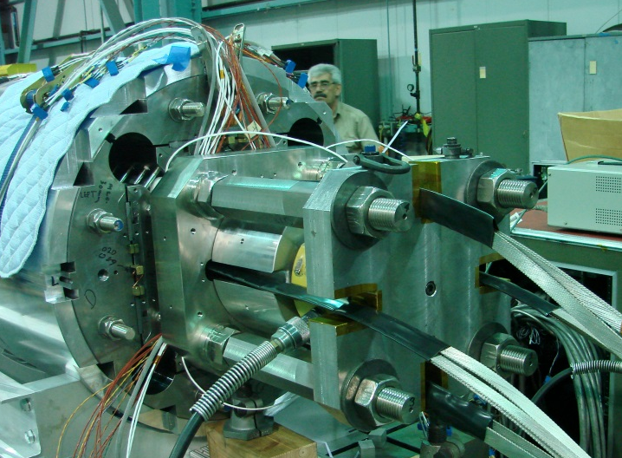
Preloading
Preload based on experience from the HQ series
Double SG system LARP/ CERN for comparison during excitation
  => goal is to decide the most efficient system for the long prototype
Azimuthal loading
Axial loading
Load key shims:
50 mil
60 mil
63 mil
4000psi
Target: 1147 μm
Target: 819 μm
3500psi
2500psi
Top
Right
Bottom
Left
2000psi
1000psi
1500psi
1500psi
Bladder pressure by quadrant
From 2500 psi to Max: 4200 psi

Slide 16
Conclusions
The single coil test showed that MQXFS coil design & fabrication technology are fine (up to 90% SSL)
The Assembly Test showed that we can reach target pre-load
We expect Cold Assembly Test to confirm pre-load at 1.9 K
➔ plan for 1st model test (Feb 2016)

Slide 17
Extra Slides

Slide 18
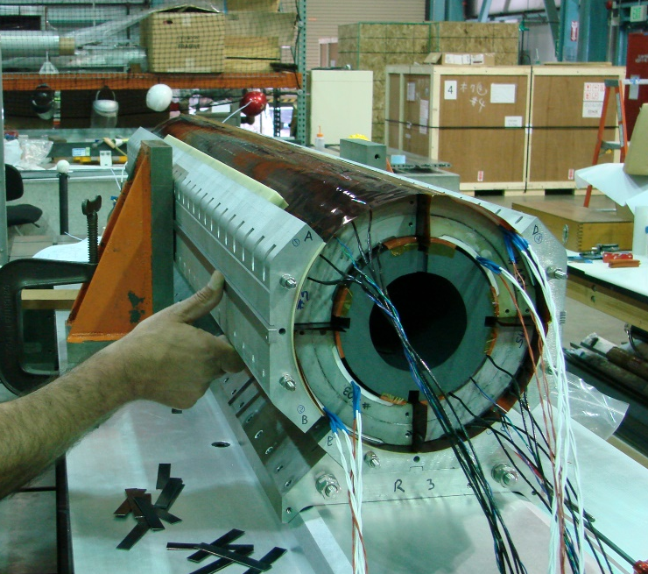
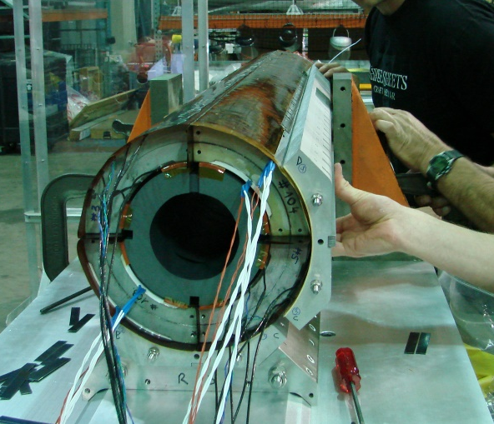
Context of the incident
Normal setup
During the incident
  The center coil support spud was not in place;
  The technicians were removing the side collar pack, the steel angle block was released
1- Disassemble the top collar stack
2 -Disassemble the collar stack #2
Steel Angle block
Coil support spud
Return End
Return End
Assembly Table
Assembly Table

Slide 19
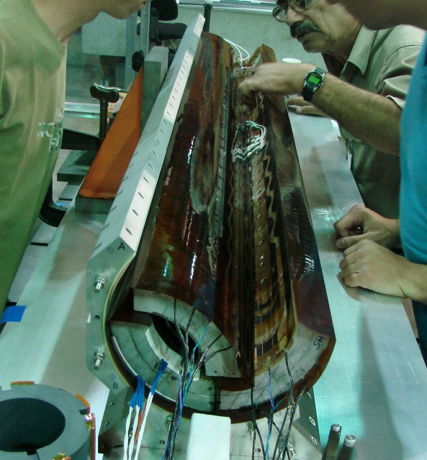
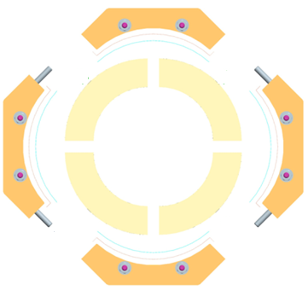

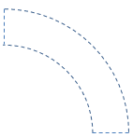

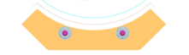
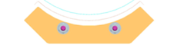
Incident sequence
Return end view
Coil 104 fell onto the assembly table,
Coil 3 fell into coil 5
Red circles indicate the edge of the coil impacting other coil or assembly table.
03
03
104
104
104
03
03
104
103
103
05
05
103
05
103
05
103
104
104
Ready to disassemble
Collars removed
Coils fell off
Return end view

Slide 20
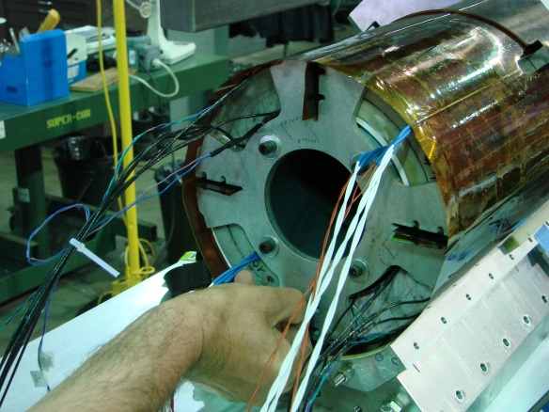
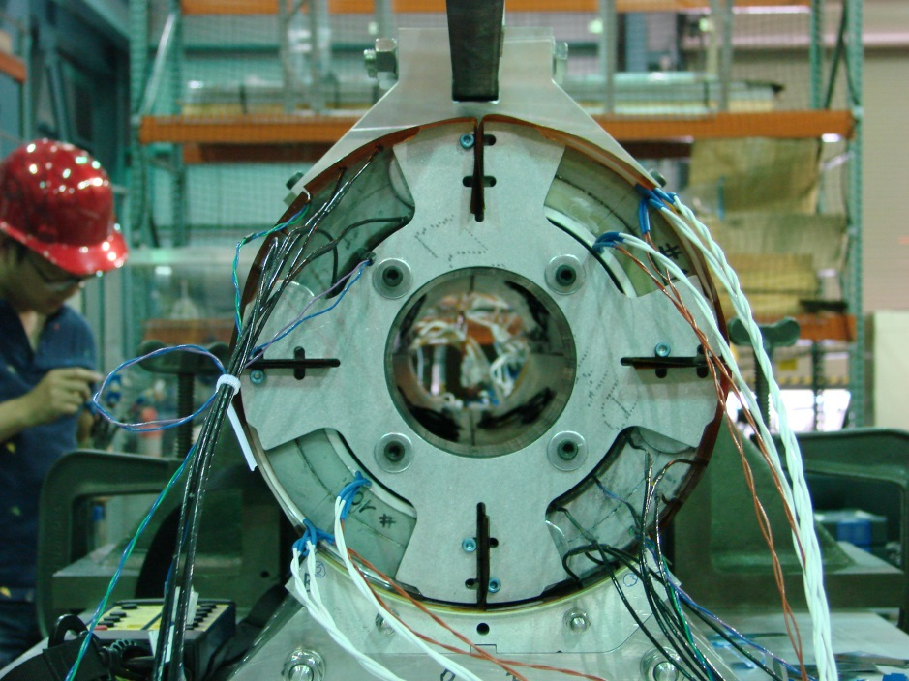
Corrective action already implemented
Modification of the spud
To capture the 4 coils
Modification of the procedure to account for missing disassembly steps
Cause analysis process started at LBNL
Will possibly lead to additional corrective actions
See Patricia Thomas’slides

Slide 21
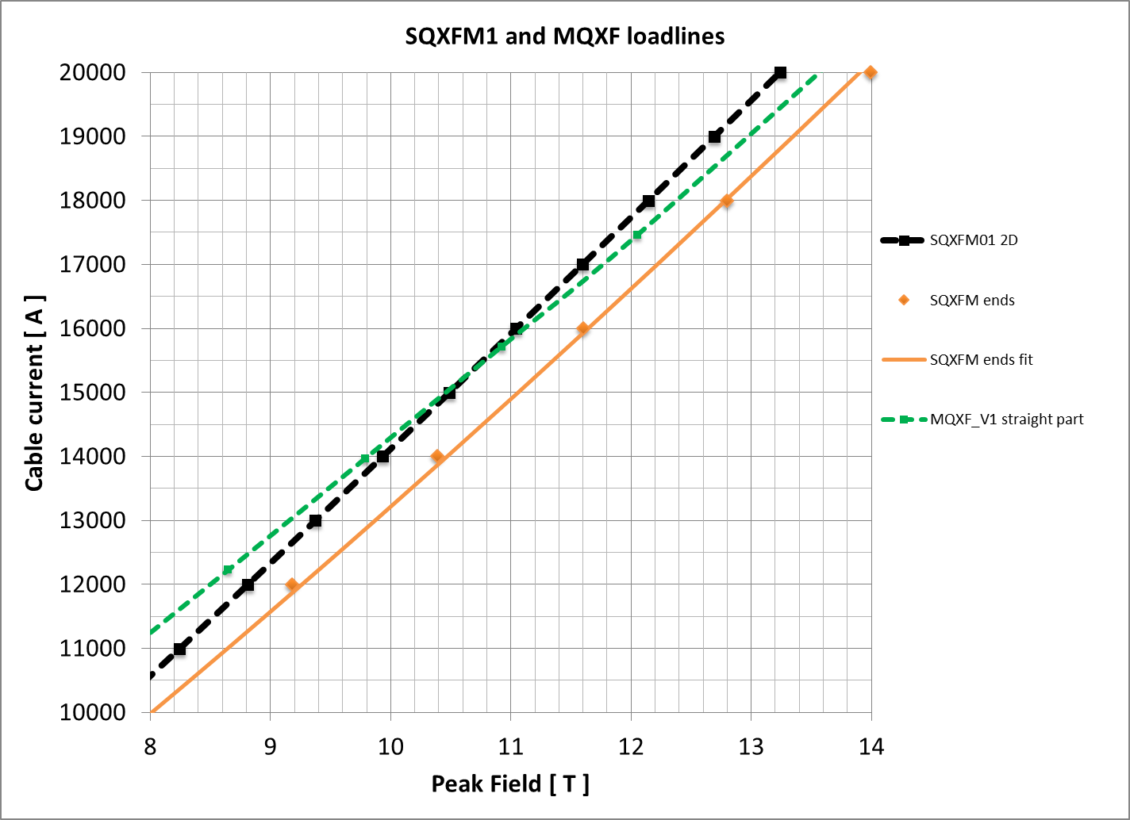
Short Coil QC (MQXFSM)
Mirror structure as coil test facility for QC:
  Load line within a few percent from MQXF load line
  Low prestress to avoid damage
Coil Protective Shell
Yoke (EDM’d blocks)
Bolt on skin
Aluminum Side Clamp
Design by
A. Zlobin & I. Novitski
Coil Midplane shim

Slide 22
Quench Locations
No quenches in low field area, only
few quenches in the OL pole-turn
segments
Established plateau quench
pattern:
Simultaneous start in a3_a4 and
a4_a5 segments, QA signals originate
in segments #1 and #2
Data analysis in progress
VT A08
VT A04
VT A03

