Slide 1
Crabs cavities @ IP4?

Slide 2
Objectives of the “investigation”
Is there any possibility to install one crab cavity module (assuming same size as one LHC ACS cavity) on each side of IP4? Where?
Is it possible to connect the crabs to the cryogenic system?
Where to install crab power stations and power lines?

Slide 3
Where Crabs could be installed?
Not possible to free space in the ACN cavities region (power lines, RF couplers, access behind the ACN)
The spare damper position is the place where the crabs could be fitted in the vicinity of IP4 (see drawing)
In case the spare dampers need to be installed (only LHC operation will tell us), there will be no possibility to install crab cavities at IP4.

Slide 4
How to feed the crabs with LHe?
It is not possible to connect to the existing ACS line (feeding the ACS cavities)
Therefore, integration and installation of a dedicated jumper must be studied
Requires detailed study
Jumpers diameter might be bigger than QRL diameter ? (see ACS jumper on drawing) ➔ does it affects the crab cryostat?
Jumpers installation is very complicated (de-installation of beam lines equipment, cutting off of the QRL)
Expensive (>0.5MCHF)

Slide 5
How to power the crabs?
Restricted space available in the Uls (where the ACN power stations will be installed)
How many square meters are required for crab power stations?
Need detailed integration of the power lines, water cooling distribution, etc required (very busy area)

Slide 6
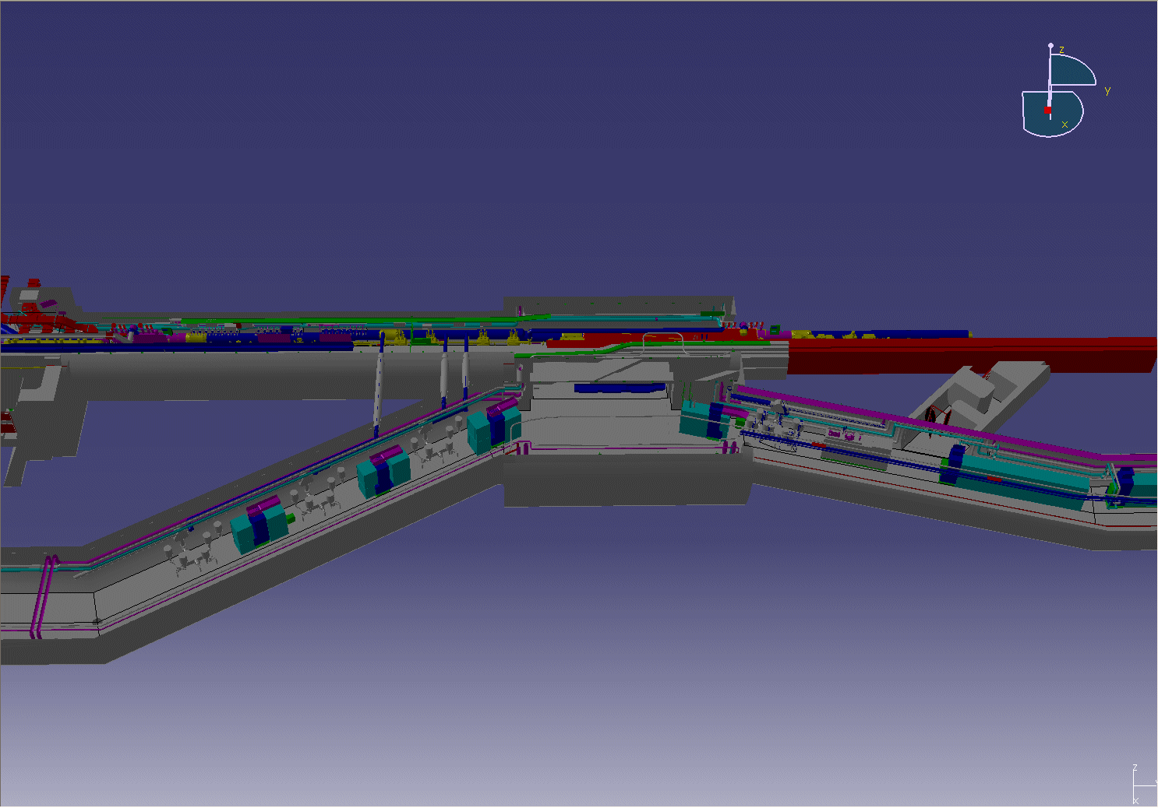
General view (IP4 left)
ACN power
ACN power

Slide 7
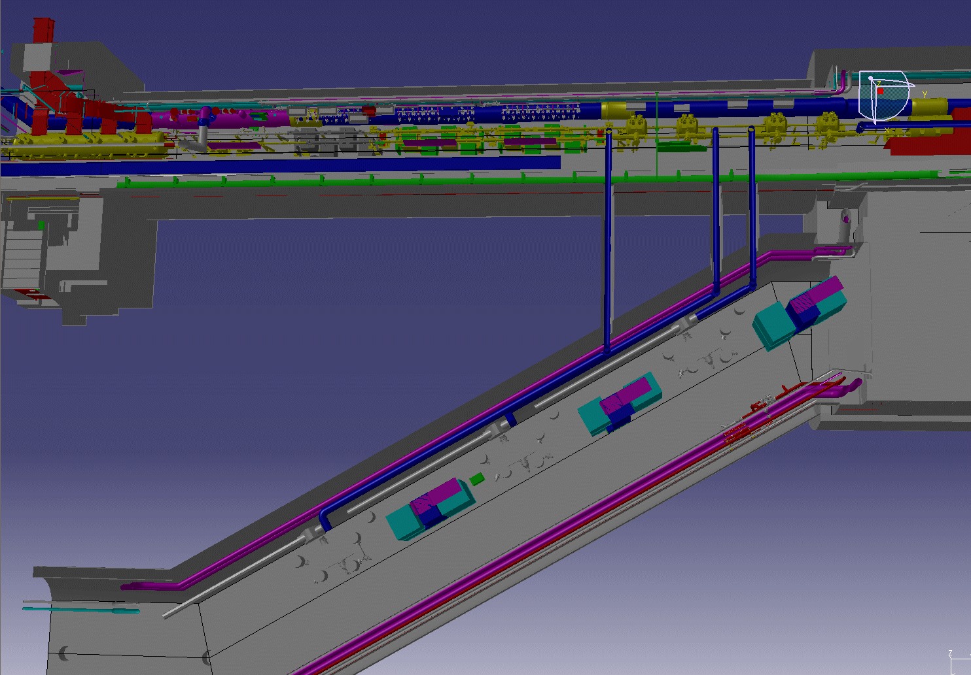
IP4
ARC 34
ACS jumper
ACS cavities
APWs
SPARE ADT
ADT
ACN
ACN power
Crab power?

Slide 8
Conclusion
The spare damper region is the only possible place susceptible to host the crab cavities at IP4. In case these additional dampers are need for future operation, installation of the crabs will not be possible (in IP4).
Connecting the crabs from the QRL looks possible (there is no other solution). More detailed study is required.
The crab power stations could be installed next to the ACN power stations in the Uls. Detailed integration needed.

