Slide 1
Code benchmarking
Wolfram Fischer
LARP Mini-Workshop on E-Lens Simulations
3 December 2008

Slide 2
Benchmarking
Short-term measures to benchmark
Only footprints?
Tevatron experiments with Gaussian gun
Long-term measures to benchmark
Beam lifetime
Emittance growth
In simulations tune/coupling/ chromaticity (which other?) should be varied by experimental/operational uncertainty
Free parameters?
What is good enough?

Slide 3
Emittance growth
ΔQ = 0.001
Δ(ΔQ_{min}) = 0.001
ΔQ’ = 2
H.J. Kim CM10

Slide 4
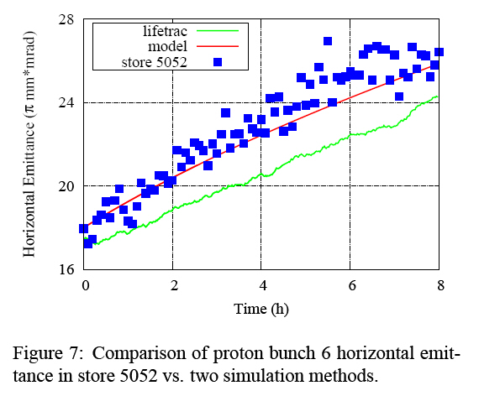
Emittance growth
A. Valishev EPAC2008

Slide 5
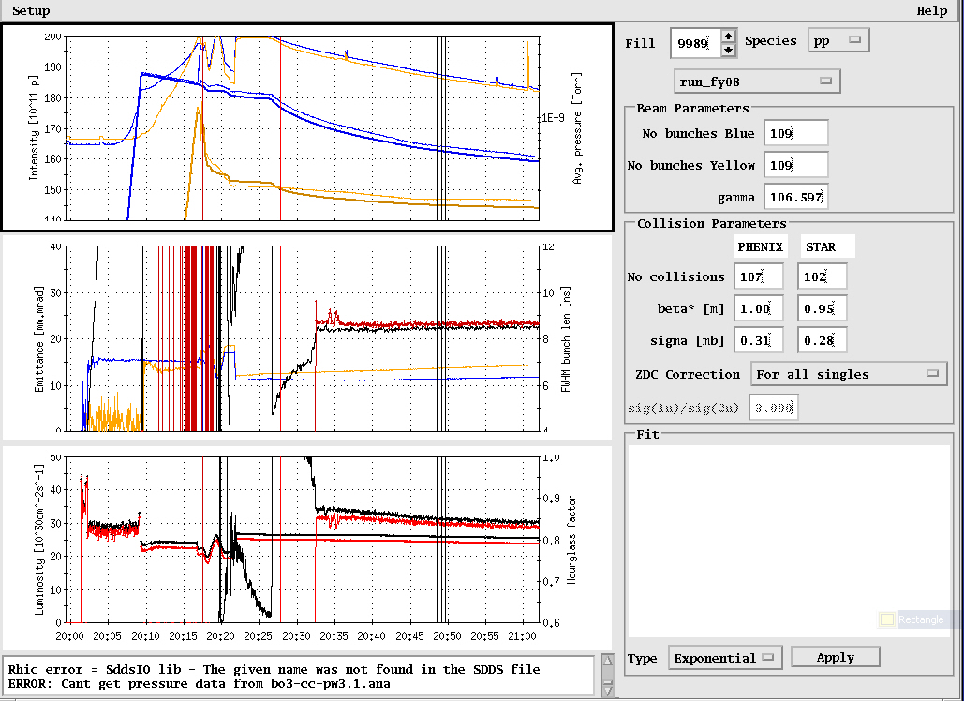
Beam lifetime
RHIC benchmark stores: 9981, 9983, 9986, 9989, 9990
5min
ΔQ = 0.001
Δ(ΔQ_{min}) = 0.001
ΔQ’ = 2

