Slide 1
Expected beam-beam effects in LHC
A few slides from Frank Zimmermann
Selected by Wolfram Fischer
LARP Mini-Workshop on E-Lens Simulations
3 December 2008

Slide 5
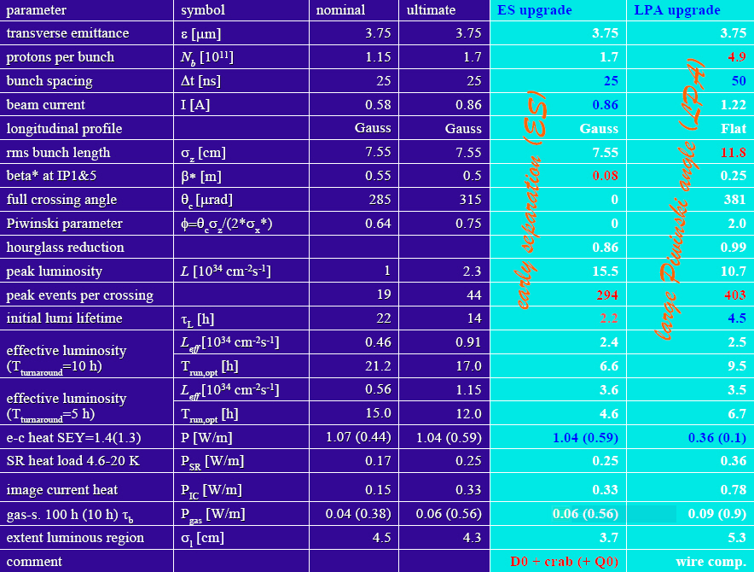
Expected beam-beam effects in the LHC
F. Zimmermann, SLAC Workshop 2008

Slide 6
Expected beam-beam effects in the LHC

