Slide 1

LHC Upgrade
Frank Zimmermann, Walter Scandale
LARP CM12, 9 April 2009
constraints from beam dynamics & collimation,
parameter choices, upgrade scenarios, schedule
We acknowledge the support of the European Community-Research Infrastructure Activity under the FP6 "Structuring the European Research Area" programme (CARE, contract number RII3-CT-2003-506395)
Photo Courtesy K. Ohmi

Slide 2
key upgrade drivers:
head-on beam-beam limit
detector pile up
long-range beam-beam effects
crossing angle
collimation & machine protection
beam from injectors
heat load (SR, impedance, e-cloud)

Slide 3
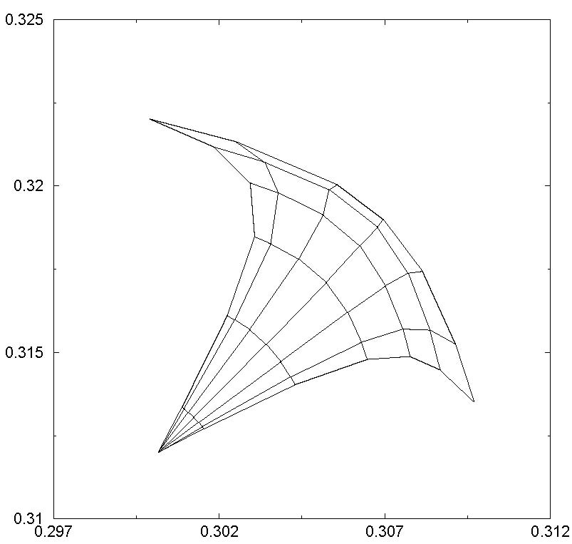
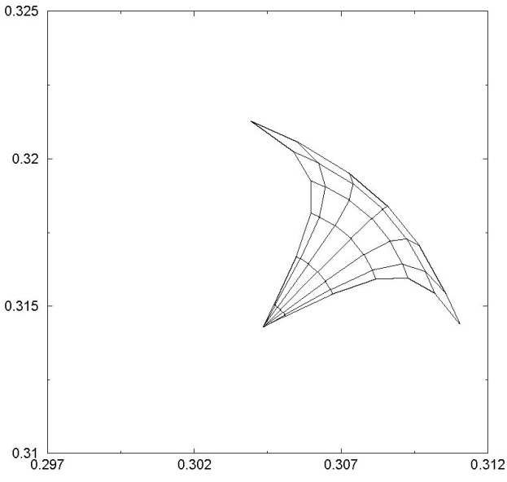
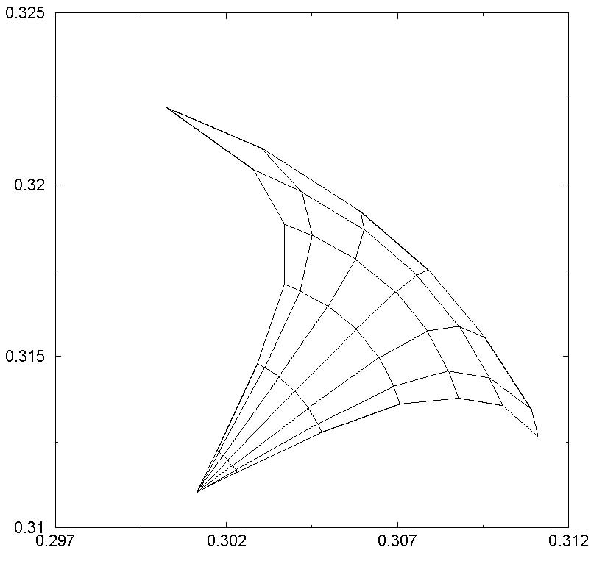
head-on beam-beam limit
from 2001 upgrade feasibility study, LHC Project Report 626
β*~0.5 m
β*~0.5 m
nominal
ultimate
~0.01
~0.01
~0.01
~0.01
nominal tune footprint
up to 6σ with 4 IPs & nom.
intensity N_{b}=1.15x10¹¹
tune footprint up to 6σ
with 2 IPs at ultimate
intensity N_{b}=1.7x10¹¹
tune footprint up to 6σ with nominal intensity
and 2 IPs
L=10³⁴ cm⁻²s⁻¹
L=2.3x10³⁴ cm⁻²s⁻¹
SPS: beam-beam limit ↔ total tune shift ΔQ~0.01 (Tevatron: 0.02?!)
going from 4 to 2 IPs ATLAS & CMS luminosity can be increased by factor 2.3
further, increasing crossing angle to 340 μrad, bunch length (x2), & bunch
charge to N_{b}=2.6x10¹¹ would yield L=3.6x10³⁴ cm⁻²s⁻¹ (β*=0.5 m still)
beam-beam limit ↔ bunch charge!

Slide 4
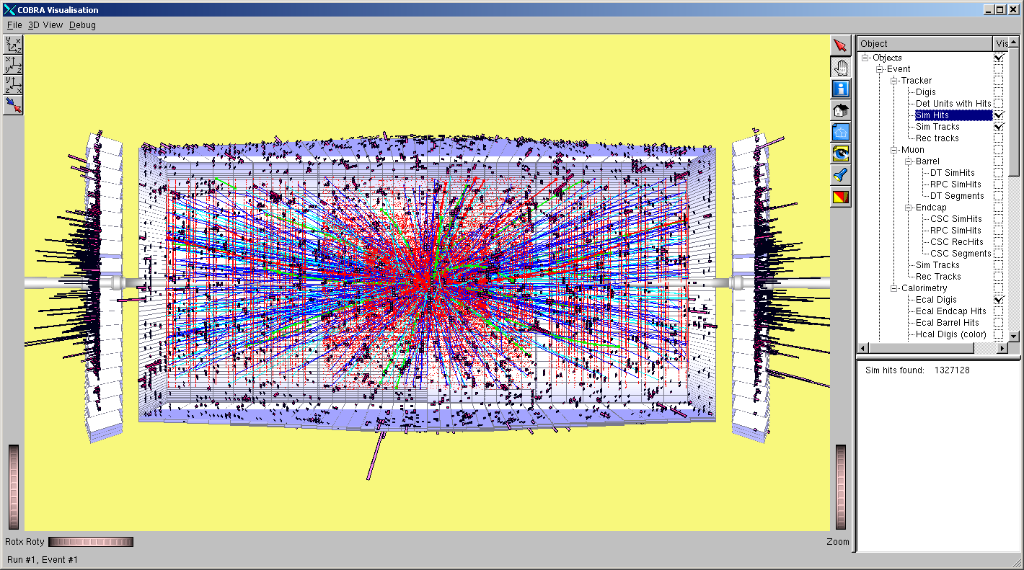
detector pile up
< 200-300 events/#ing!?
10³⁵cm⁻²s⁻¹
I. Osborne
↔ bunch spacing!
generated tracks per crossing,
p_{t} > 1 GeV/c cut, i.e. soft tracks removed!

Slide 5
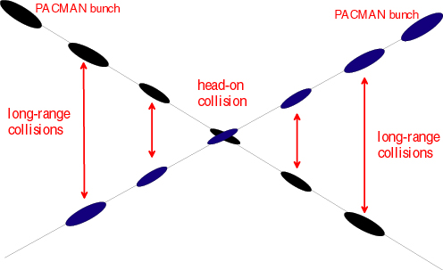
long-range (LR) beam-beam
30 LR collisions / IP,
120 in total
→ beam losses, poor beam lifetime
↔ minimum crossing angle & β*, aperture!

Slide 6
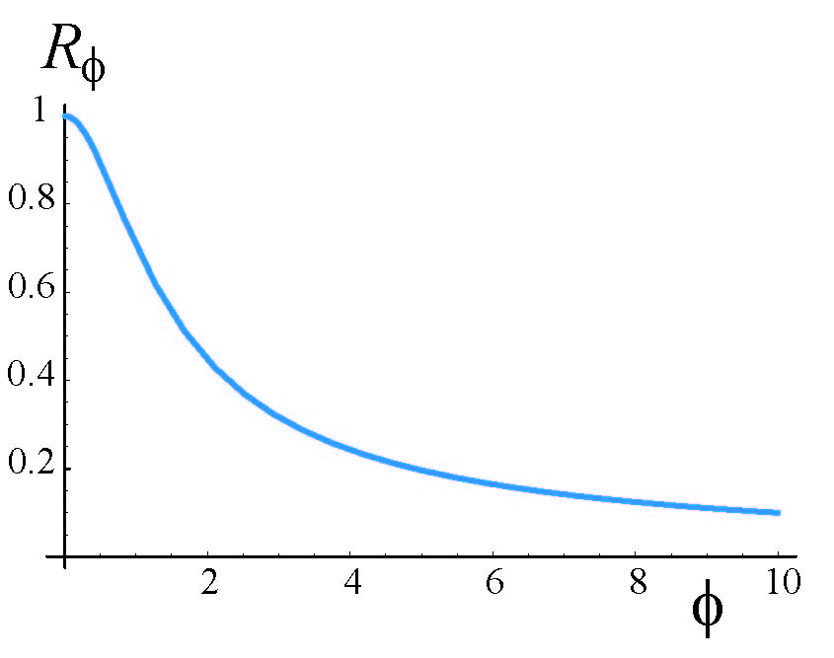
crossing angle
luminosity reduction factor
“Piwinski angle”
nominal LHC
θ_{c}/2
effective beam
size σ→σ/R_{φ}
→ luminosity loss, poor beam lifetime
↔ bunch length, β*, crab cavities, emittance,
early separation scheme!

Slide 7
collimation
R. Assmann, HHH-2008
main task: quench protection: 1% beam loss in 10 s at 7 TeV ~ 500 kW energy ; quench limit = 8.5 W/m!
simulated cleaning efficiency w. errors allows only ~5% of nominal intensity for assumed loss rate
IR upgrade will not improve intensity limit
“phase-II” collimation with (sacrificial or consumable?) Cu & cryogenic collimators under study ; predicted factor 30 improvement in cleaning efficiency: 99.997 %/m → 99.99992 %/m ; ready for nominal and higher intensity in 2012?!

Slide 8
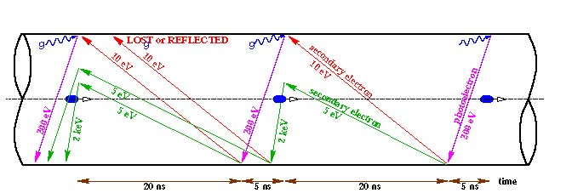
electron cloud
[F. Ruggiero]
schematic of e- cloud build up in LHC beam pipe,
due to photoemission and secondary emission
→ heat load (→ quenches), instabilities,
emittance growth, poor beam lifetime
also synchrotron radiation & beam image currents add to heat load
↔ bunch spacing, bunch charge & bunch length!

Slide 9
injector limitations
nominal LHC beam ~ present performance limit
ultimate LHC beam out of reach
component aging & reliability problems
important limiting mechanisms like space charge, & aperture are common to all injectors and will “profit” from an injection energy increase; in particular the PSB will profit from new LINAC4
TMCI is a major limitation for PS and SPS and an increase in |η| is necessary (avoid transition crossing and γ_{inj}>>γ_{tr})
G. Arduini, BEAM’07

Slide 10

development of scenarios
2001/02 feasibility study (LHC Project Report 626):
“phase 0” – no HW changes
“phase 1” – IR upgrade, 12.5 ns or superbunches
“phase 2” – major HW changes; injector upgrade
32 workshops
156 documents
HHH-2004: superbunches †
LUMI’05: IR upgrade w. NbTi
and β*=0.25 m, “LPA”
scheme; “early separation”
LUMI’06: 12.5 ns †
“dipole first schemes” †
BEAM’07: beam production;
luminosity leveling;
“full crab crossing”
HHH-2008: “low emittance”

Slide 11
LHC upgrade stages
“phase 1” ~2013, 2x10³⁴ cm⁻²s⁻¹:
new NbTi triplets, D1, TAS,
β*~0.25-0.3 m in IP1 & 5,
beam from new Linac4
“phase 2” ~2017, ~10³⁵ cm⁻²s⁻¹ :
possibly Nb₃Sn triplet & β*~0.15 m
complementary measures 2010-2017:
e.g. long-range beam-beam compensation,
crab cavities, advanced collimators, crab waist?
[, coherent e- cooling??, e- lenses??]
longer term (2020?): energy upgrade, LHeC,…
+ injector
upgrade
phase-2 might be just phase 1 plus complementary measures

Slide 12
present and future injectors
Proton flux / Beam power
50 MeV
Linac2
Linac4
160 MeV
PSB
(LP)SPL
1.4 GeV
4 GeV
(LP)SPL: (Low Power) Superconducting Proton Linac (4-5 GeV)
PS2: High Energy PS
(~ 5 to 50 GeV – 0.3 Hz)
SPS+: Superconducting SPS
(50 to1000 GeV)
SLHC: “Superluminosity” LHC
(up to 10³⁵ cm⁻²s⁻¹)
DLHC: “Double energy” LHC
(1 to ~14 TeV)
26 GeV
PS
PS2
50 GeV
Output energy
450 GeV
SPS
SPS+
1 TeV
LHC /
SLHC
DLHC
7 TeV
~ 14 TeV
Roland Garoby, LHCC 1July ‘08

Slide 13
LHC “phase-2” scenarios
early separation (ES)
    β*~0.1 m, 25 ns, N_{b}=1.7x10¹¹,
    detector embedded dipoles
full crab crossing (FCC)
    β*~0.1 m, 25 ns, N_{b}=1.7x10¹¹,
    local and/or global crab cavities
large Piwinski angle (LPA)
    β*~0.25 m, 50 ns, N_{b}=4.9x10¹¹,
    “flat” intense bunches
low emittance (LE)
    β*~0.1 m, 25 ns, γε~1-2 μm, N_{b}=1.7x10¹¹

Slide 14
“phase-2” IR layouts
early separation (ES)
J.-P. Koutchouk
full crab crossing (FCC)
stronger triplet magnets
L. Evans,
W. Scandale,
F. Zimmermann
D0 dipole
stronger triplet magnets
small-angle
crab cavity
small-angle
crab cavity
early-separation dipoles in side detectors , crab cavities
→ hardware inside ATLAS & CMS detectors,
first hadron crab cavities; off-δ β
crab cavities with 60% higher voltage
→ first hadron crab cavities, off-δ β-beat
large Piwinski angle (LPA)
low emittance (LE)
R. Garoby
larger-aperture triplet magnets
stronger triplet magnets
F. Ruggiero,
W. Scandale.
F. Zimmermann
wire
compensator
long-range beam-beam wire compensation
→ novel operating regime for hadron colliders,
beam generation
smaller transverse emittance
→ constraint on new injectors, off-δ β-beat

Slide 15
parameter | symbol | nominal | ultimate | ES | FCC | LE (1) | LPA
transverse emittance | ε [μm] | 3.75 | 3.75 | 3.75 | 3.75 | 1.0 | 3.75
protons per bunch | N_{b} [10¹¹] | 1.15 | 1.7 | 1.7 | 1.7 | 1.7 | 4.9
bunch spacing | Δt [ns] | 25 | 25 | 25 | 25 | 25 | 50
beam current | I [A] | 0.58 | 0.86 | 0.86 | 0.86 | 0..86 | 1.22
longitudinal profile |  | Gauss | Gauss | Gauss | Gauss | Gauss | Flat
rms bunch length | σ_{z} [cm] | 7.55 | 7.55 | 7.55 | 7.55 | 7.55 | 11.8
beta* at IP1&5 | β∗ [m] | 0.55 | 0.5 | 0.08 | 0.08 | 0.1 | 0.25
full crossing angle | θ_{c} [μrad] | 285 | 315 | 0 | 0 | 311 | 381
Piwinski parameter | φ=θ_{c}σ_{z}/(2*σ_{x}*) | 0.64 | 0.75 | 0 | 0 | 3.2 | 2.0
geometric reduction |  | 1.0 | 1.0 | 0.86 | 0.86 | 0.30 | 0.99
peak luminosity | L [10³⁴ cm⁻²s⁻¹] | 1 | 2.3 | 15.5 | 15.5 | 16.3 | 10.7
peak events per #ing |  | 19 | 44 | 294 | 294 | 309 | 403
initial lumi lifetime | τ_{L} [h] | 22 | 14 | 2.2 | 2.2 | 2.0 | 4.5
effective luminosity (T_{turnaround}=10 h) | L_{eff} [10³⁴ cm⁻²s⁻¹] | 0.46 | 0.91 | 2.4 | 2.4 | 2.5 | 2.5
 | T_{run,opt} [h] | 21.2 | 17.0 | 6.6 | 6.6 | 6.4 | 9.5
effective luminosity (T_{turnaround}=5 h) | L_{eff} [10³⁴ cm⁻²s⁻¹] | 0.56 | 1.15 | 3.6 | 3.6 | 3.7 | 3.5
 | T_{run,opt} [h] | 15.0 | 12.0 | 4.6 | 4.6 | 4.5 | 6.7
e-c heat SEY=1.4(1.3) | P [W/m] | 1.1 (0.4) | 1.04(0.6) | 1.0 (0.6) | 1.0 (0.6) | 1.0 (0.6) | 0.4 (0.1)
SR heat load 4.6-20 K | P_{SR} [W/m] | 0.17 | 0.25 | 0.25 | 0.25 | 0.25 | 0.36
image current heat | P_{IC} [W/m] | 0.15 | 0.33 | 0.33 | 0.33 | 0.33 | 0.78
gas-s. 100 h (10 h) τ_{b} | P_{gas} [W/m] | 0.04 (0.4) | 0.06 (0.6) | 0.06 (0.56) | 0.06 (0.56) | 0.06 (0.56) | 0.09 (0.9)
extent luminous region | σ_{l} [cm] | 4.5 | 4.3 | 3.7 | 3.7 | 1.6 | 5.3
comment |  | nominal | ultimate | D0 + crab | crab |  | wire comp.

Slide 16
upgrade bunch patterns
nominal
25 ns
ultimate
& 25-ns upgrade
(ES, FCC, & LE)
25 ns
50-ns upgrade (LPA),
no collisions in LHCb!
50 ns
50-ns upgrade
with 25-ns
collisions
in LHCb
50 ns
25 ns

Slide 17
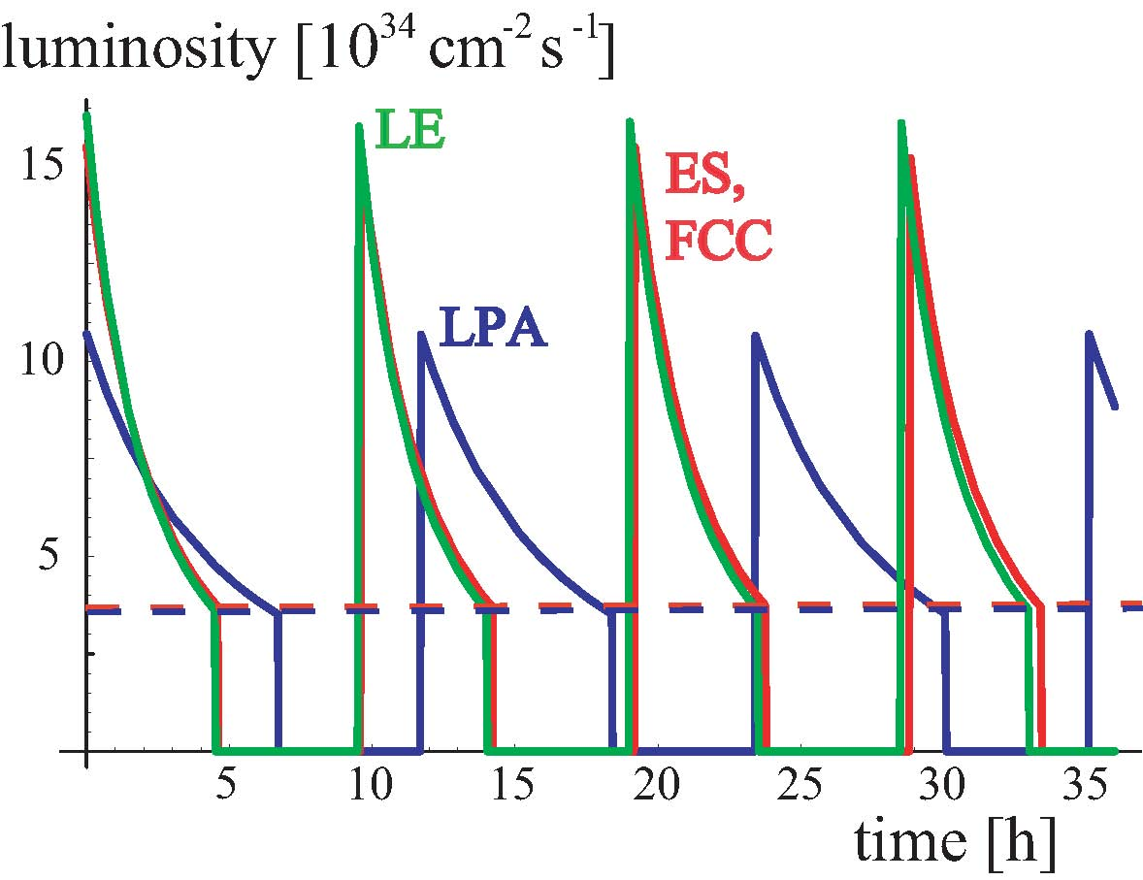
luminosity evolution
average
luminosity

Slide 18
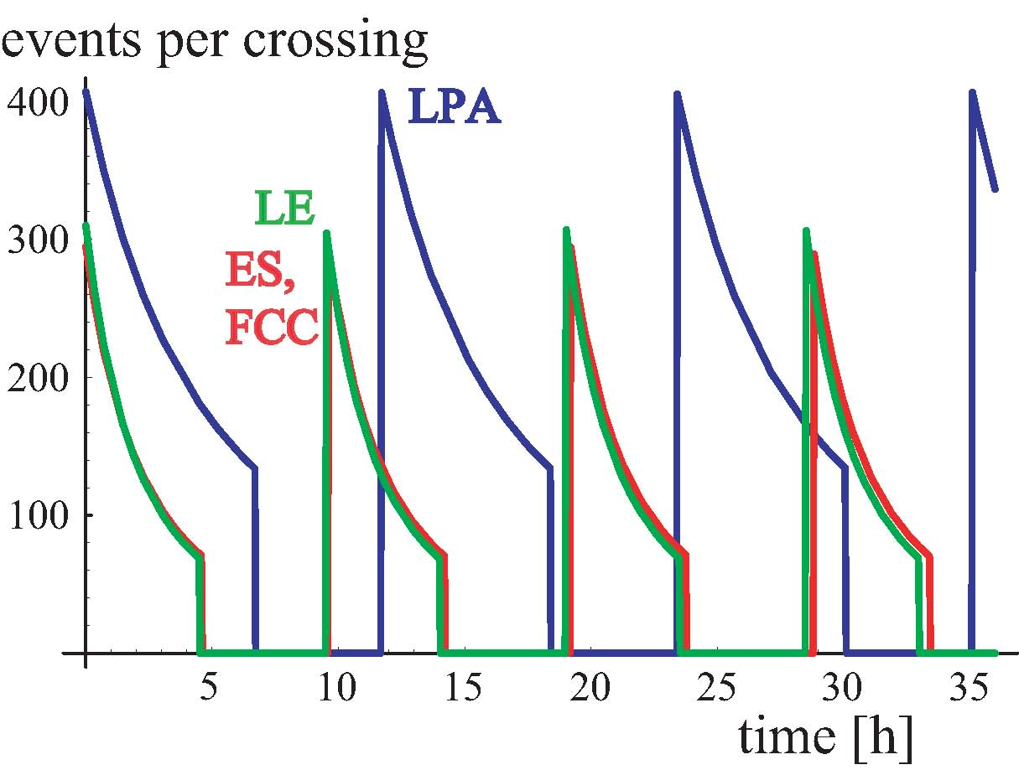
event pile up

Slide 19

b.-b. ΔQ & peak luminosity
Piwinski angle
total beam-beam tune shift at 2 IPs with alternating crossing;
we increase charge N_{b} until limit ΔQ_{bb} is reached; to go further
we must increase φ_{piw}, and/or ε and/or F_{profile} (~2^{1/2} for flat bunches)
at the b-b limit, larger Piwinski angle &/or larger emittance increase luminosity

Slide 20
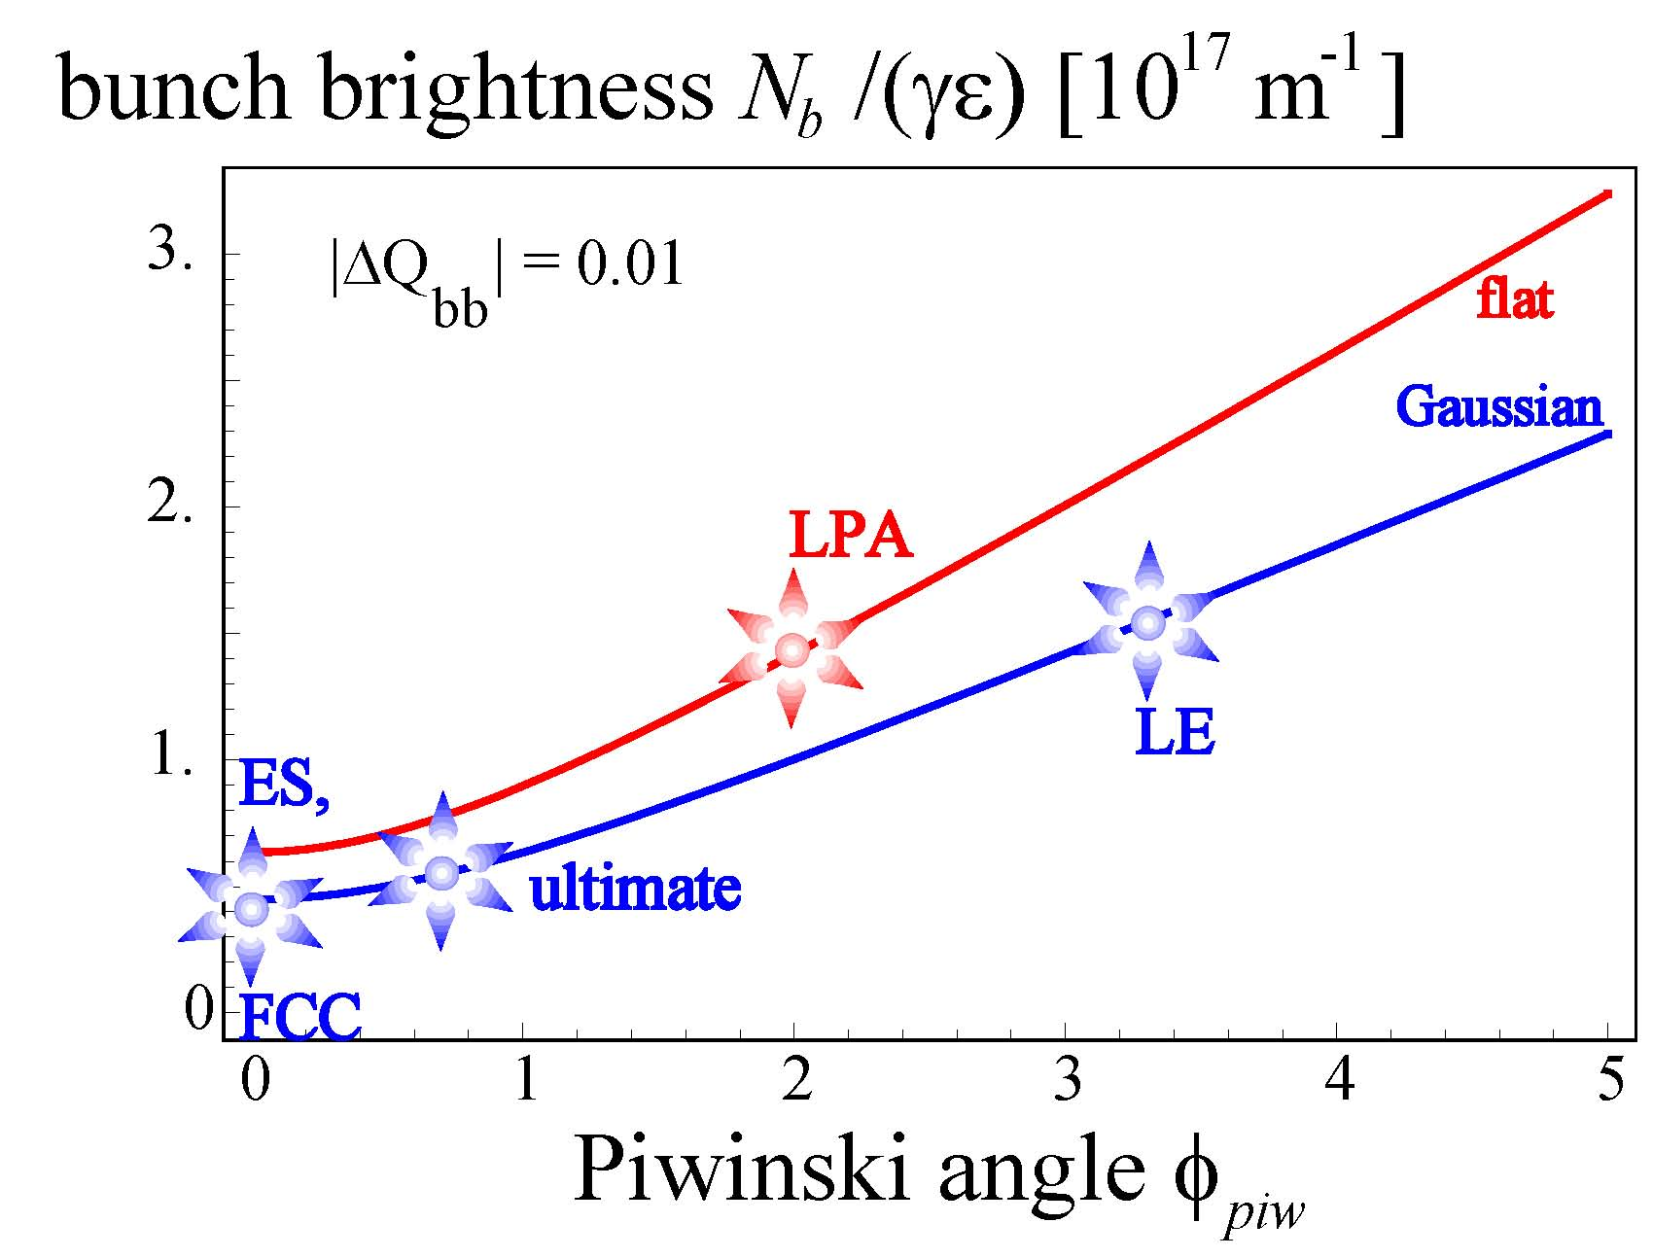
N_{b}/(γε) vs φ_{piw} plane
higher brightness
requires larger Piwinski angle

Slide 21
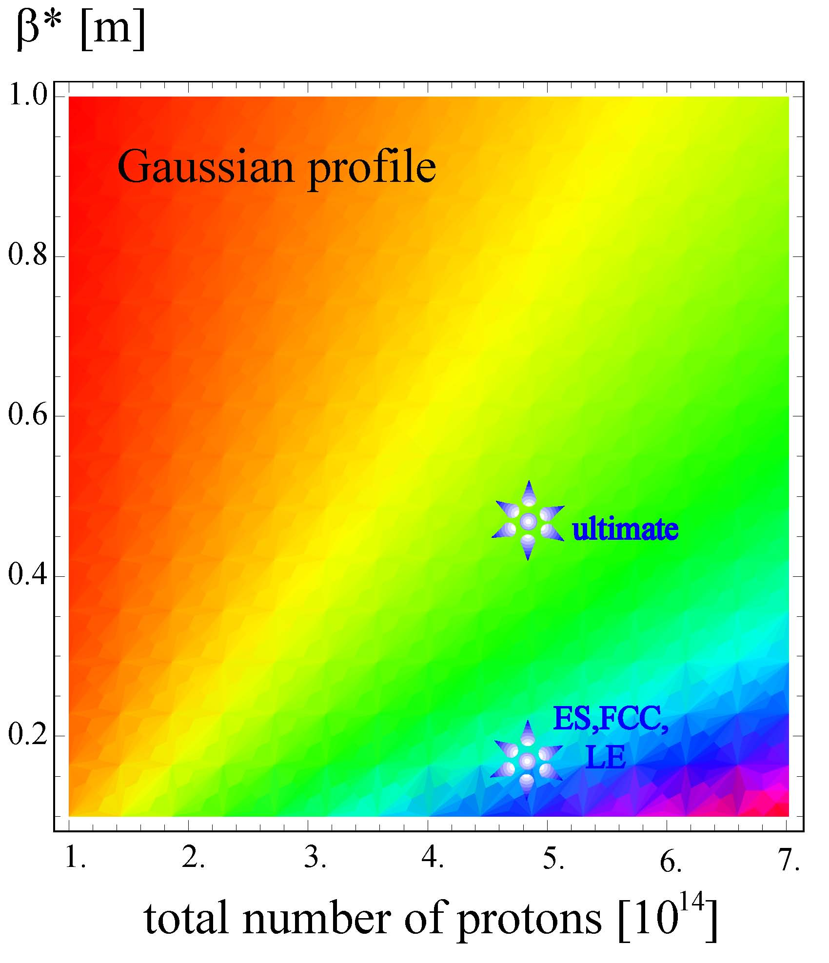
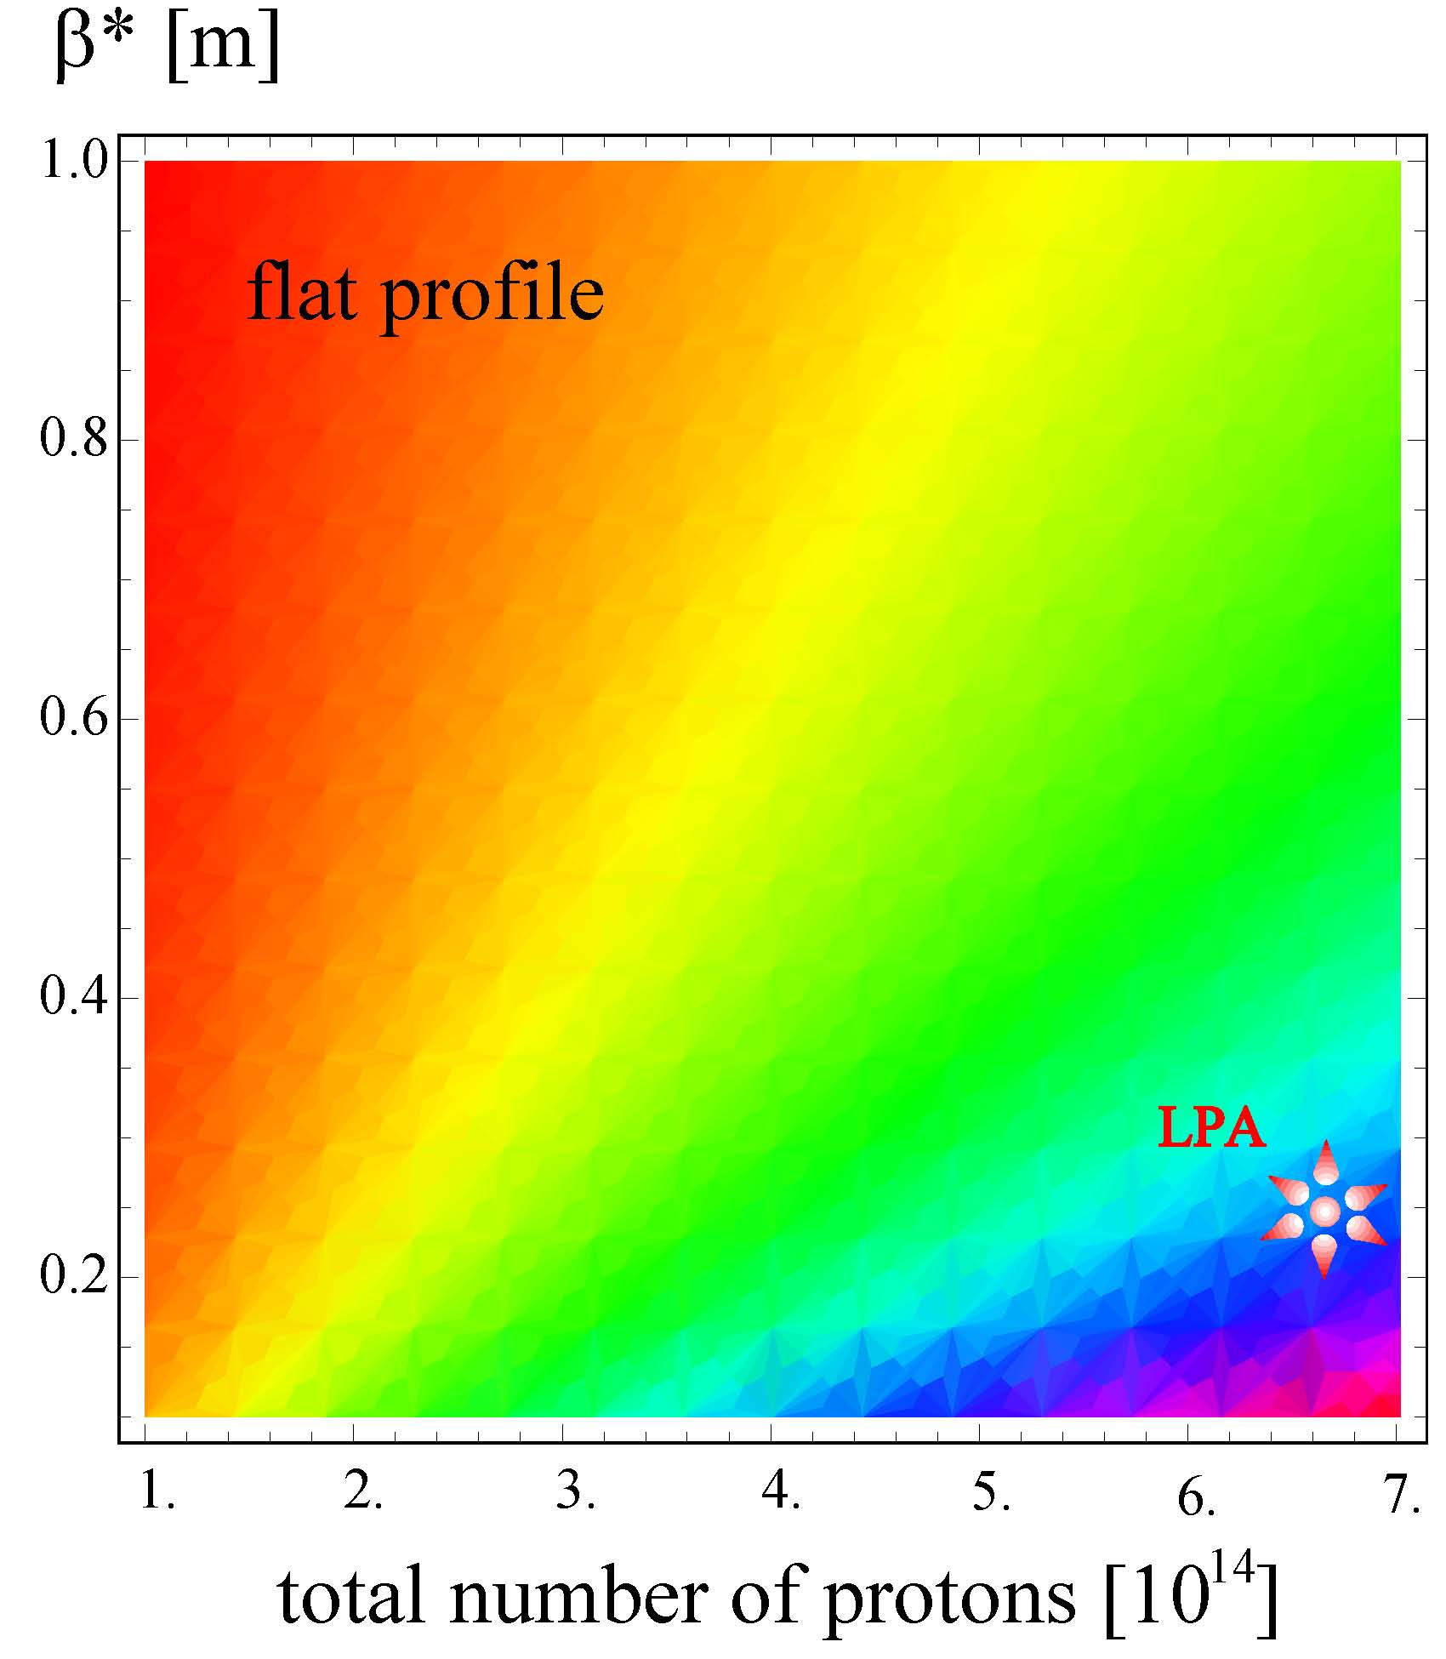
av. luminosity vs #p’s & β*
“linear” scale from 10³³ to 2x10³⁵ cm⁻²s⁻¹

Slide 22
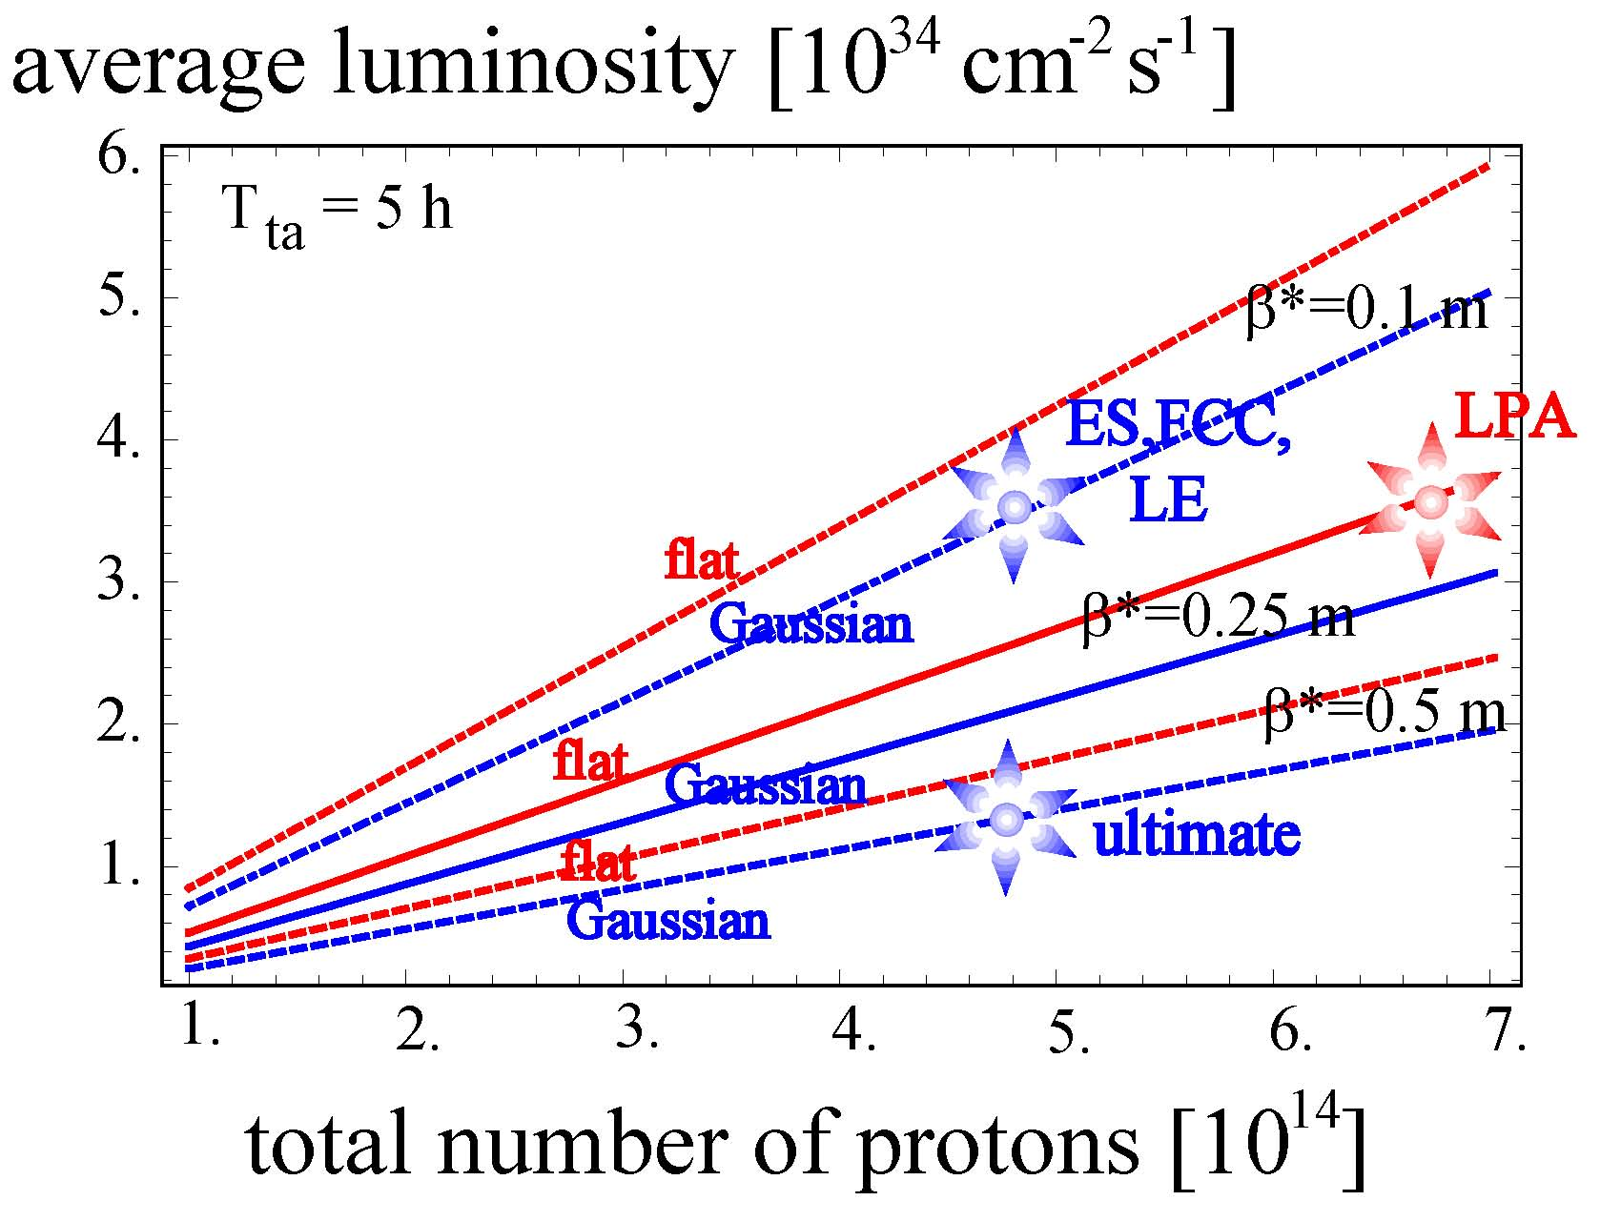
av. luminosity vs #p’s
factor 1/(2.5) in β*
= factor 1.4-1.6 in intensity

Slide 23
nominal?
make LHCb
and ALICE
transparent
increase
bunch intensity
(to maximal
1.7-2.4 x 10¹¹ )
possible
LHC upgrade
roadmap
IR-1: reduce
β* to 25 cm
& increase θ_{c}
50 ns spacing
& increase bunch
intensity to
5x10¹¹, flat shape
IR-2: reduce
β* to <15 cm & install local
crab cavities
if current not limited
if β*
not limited

Slide 24
luminosity leveling
experiments prefer constant luminosity: less pile up at start of run, and higher luminosity at the end of a physics store
how can we achieve this?
ES, or FCC: dynamic β squeeze, or dynamic θ change (either IP angle bumps or varying crab voltage); LE: β or θ change;
LPA: dynamic β squeeze, or dynamic change of bunch length

Slide 25
run time & av. luminosity
 | w/o leveling | with leveling
luminosity evolution
beam current evolution
optimum run time
average luminosity
luminosity lifetime scales with total # protons!

Slide 26
 | ES, FCC, or LE, with leveling | LPA, with leveling
events/crossing | 300 | 300
run time | N/A | 2.5 h
av. luminosity | N/A | 2.6x10³⁴s⁻¹cm⁻²
events/crossing | 150 | 150
run time | 2.5 h | 14.8 h
av. luminosity | 2.6x10³⁴s⁻¹cm⁻² | 2.9x10³⁴s⁻¹cm⁻²
events/crossing | 75 | 75
run time | 9.9 h | 26.4 h
av. luminosity | 2.6x10³⁴s⁻¹cm⁻² | 1.7x10³⁴s⁻¹cm⁻²
examples
assuming 5 h turn-around time

Slide 27
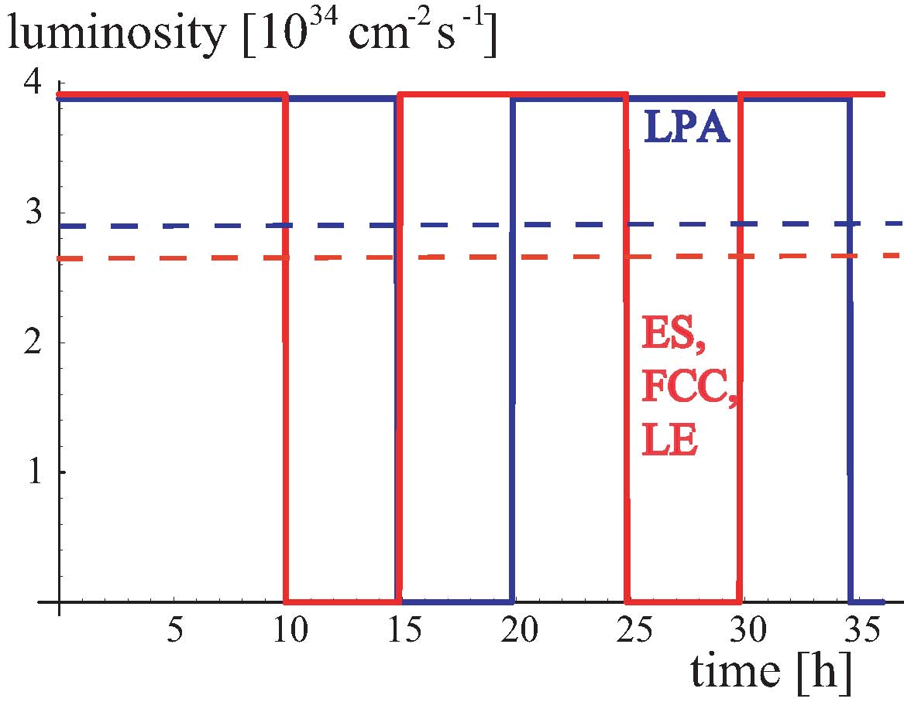
luminosity with leveling
average
luminosity

Slide 28
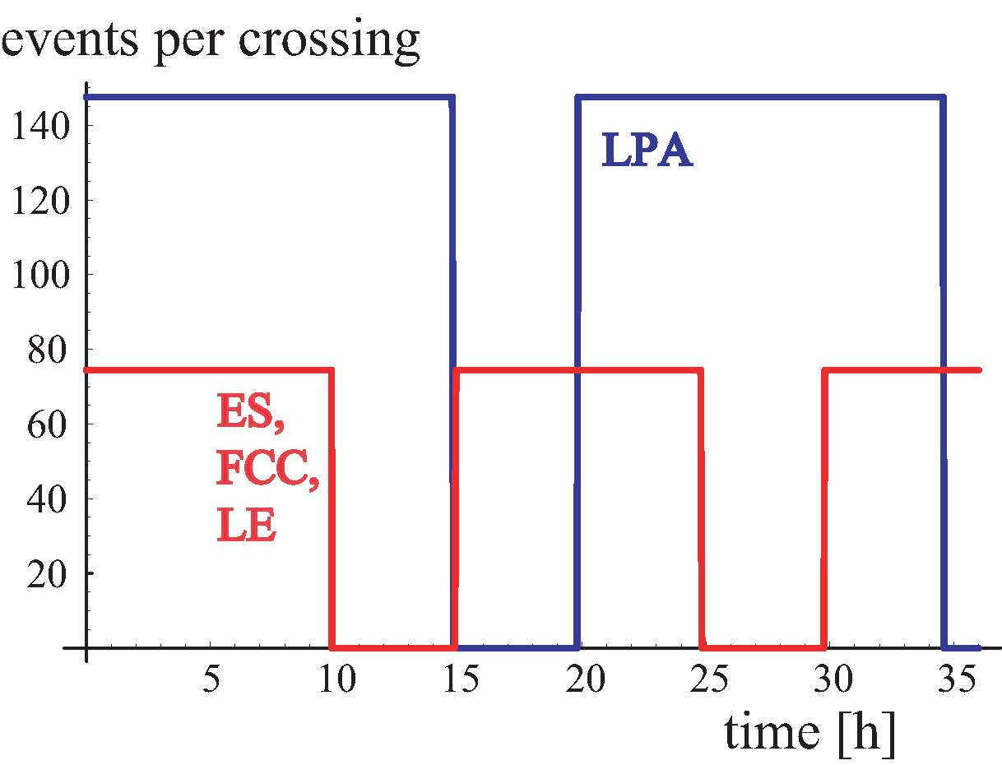
event pile up with leveling

Slide 29
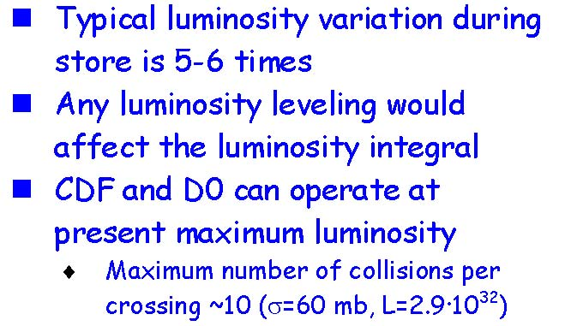
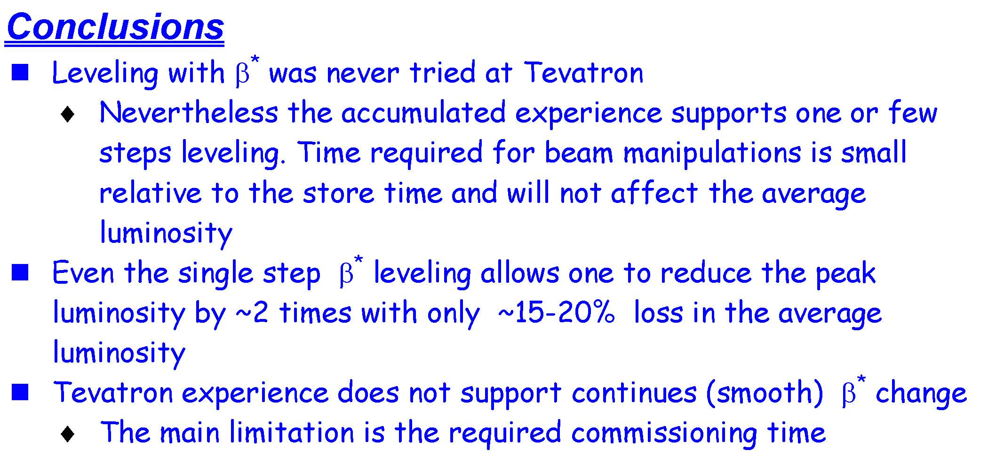
(no) experience with leveling in Tevatron Run-II
V. Lebedev, CARE-HHH BEAM’07

Slide 30
schedule after Chamonix’09
Chamonix’08 workshop → scenario for 2009/10 running
maximum resources engaged in certain technical domains, leaving little space for other work
(e.g. magnet group’s involvement in repairing S3-4 and consolidating other sectors)
→ 6-months delay in IR phase-1 magnet activities
delays in Linac4 civil works likely to shift start of Linac4 operation by one year
phase-I upgrade (experiments and accelerators) is postponed to shutdown of 2014, yielding effectively one year delay with respect to previous schedule
S. Fartoukh, R. Garoby, R. Ostojic

Slide 31

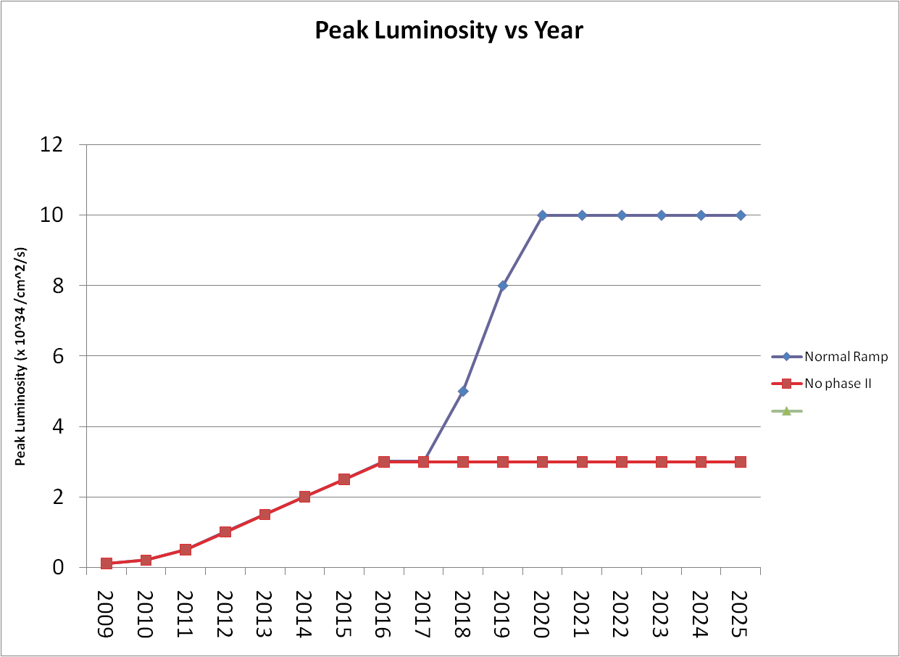
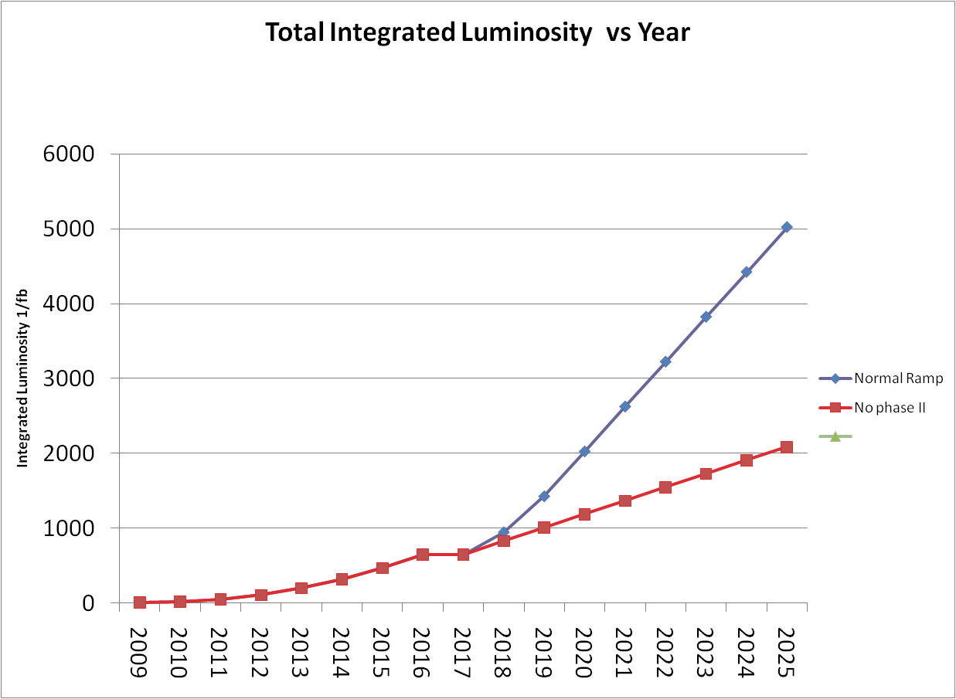
revised forecast peak & integrated luminosity evolution
New injectors + IR upgrade phase 2
ATLAS will need ~18 months shutdown
2026
2025
2024
2023
2022
2021
2020
2019
2018
2017
2016
2015
2014
2013
2012
2011
2010
2026
2025
2024
2023
2022
2021
2020
2019
2018
2017
2016
2015
2014
2013
2012
2011
2010
shifted one year
shifted one year
goal for ATLAS Upgrade:
3000 fb⁻¹ recorded
cope with ~400 pile-up events each BC
Collimation phase 2
Linac4 + IR upgrade phase 1
M. Nessi, CARE-HHH LHC crab-cavity validation mini-workshop August 2008, R. Garoby, LHCC July 08

Slide 32
more comments on the four upgrade schemes

Slide 33
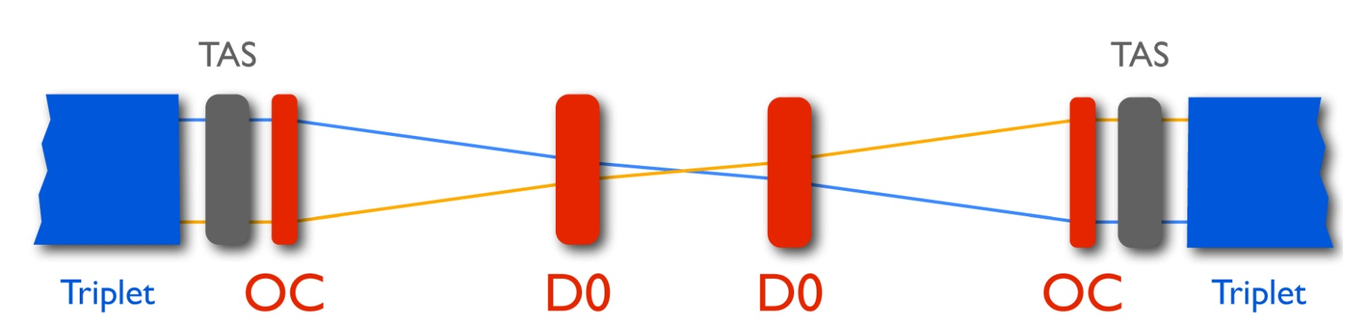
Early Separation
J.-P. Koutchouk,
G. Sterbini et al.
magnets in front of calorimeters ruled out
D0 at ~14 m from IP retained as option (HHH-2008)
integrated field of ~13T-m required for D0 at 14 m
peak luminosity gain ~30-60% for β*=0.15 m
depending on minimum acceptable beam-beam
separation between the D0’s (7 or 5σ)
heat load can be a problem (also effect of CMS solenoid, impact on background,…)

Slide 34
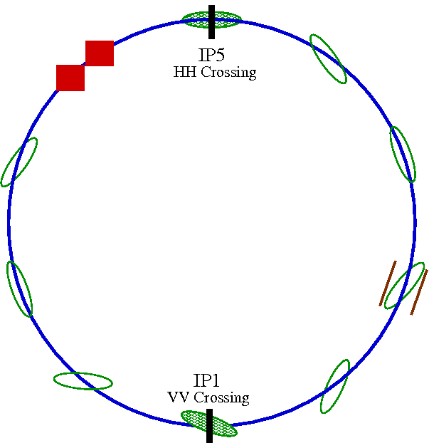
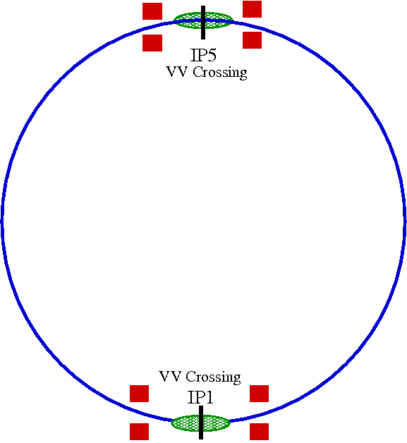
Crab Cavities – Phases
R. Calaga
Phase I:
      Test prototype – one cavity/beam (@IR4, 2014)
      Feasibility of crab crossing in hadron machine, superconducting RF limits in deflecting mode, collimation, impedance
      Operations - Cryogenics, operation at injection/ramp/top energies, luminosity gain and leveling, emittance growth
Phase II:
      Complete IR redesign (IR1 & 5) with crab crossing optics (2018?)
      Perhaps need for special compact cavities due to space constraints
Phase I
Phase II

Slide 35
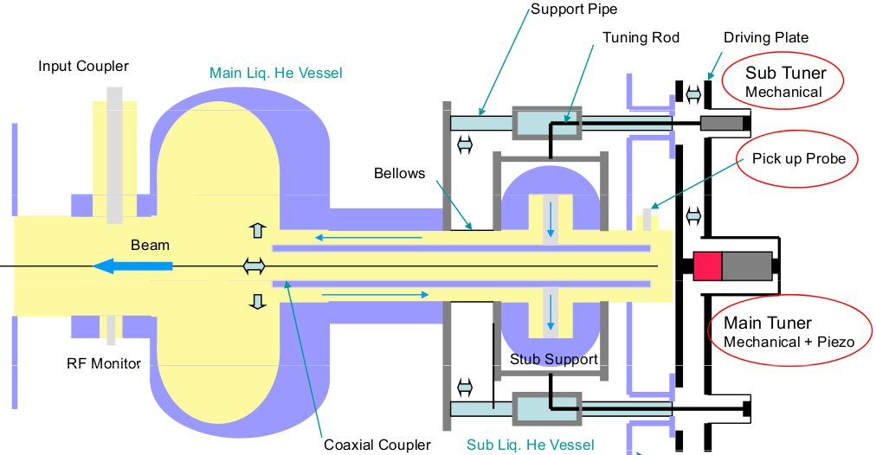
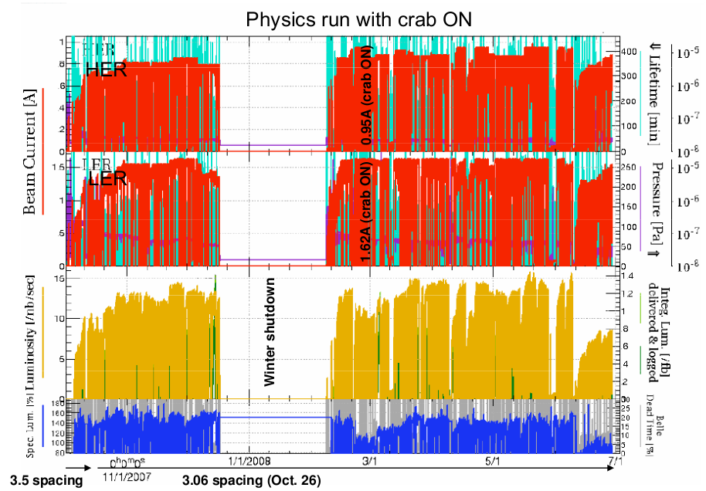
Crab Cavities: KEK-B Test Bed
No serious instabilities at high currents (1.62/0.9 A) w. crab cavities
Similar luminosity as before at ~30% lower beam current
Trip rate needs to improve for more reliable operation
Y. Morita et al (KEK-B)
KEK-B experiments will probe many LHC related concerns (Dec 08,
Spring 09), e.g. ramping, detuning
KEK-CERN-LARP crab collaboration

Slide 36
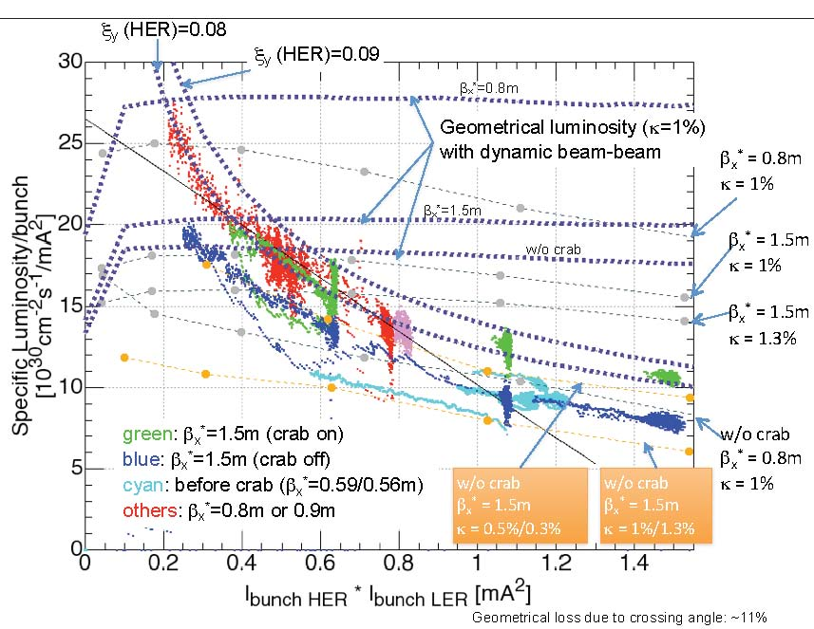
CERN-KEK crab discussion
Y. Funakoshi, 18 March 2009
ξ_{crab}~1.2 ξ_{no-crab}
for all beam currents!

Slide 37
Crab Cavities: LHC Motivations
& Challenges:
R. Calaga
~ 50% or more luminosity gain for β*=25 cm or smaller
natural luminosity leveling knob, explore beyond the BB limit
global interest in crab cavity technology, exploit synergies
    separation between two beams (190 mm in most of LHC)
    bunch length, 7.55 cm (800 MHz maximum)
    constraints from collimation/machine protection

Slide 38
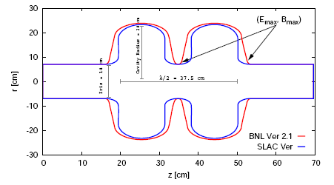
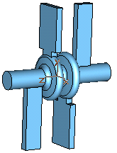
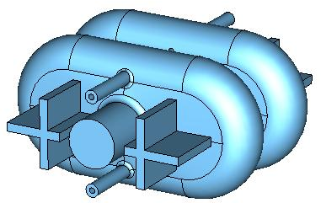
Prototype: Cavity & Couplers
R. Calaga
LARP design
Note the cavity radius ~ 23 cm
Super-KEKB type design
EUCard design
** Down-Selection within 1yr

Slide 39
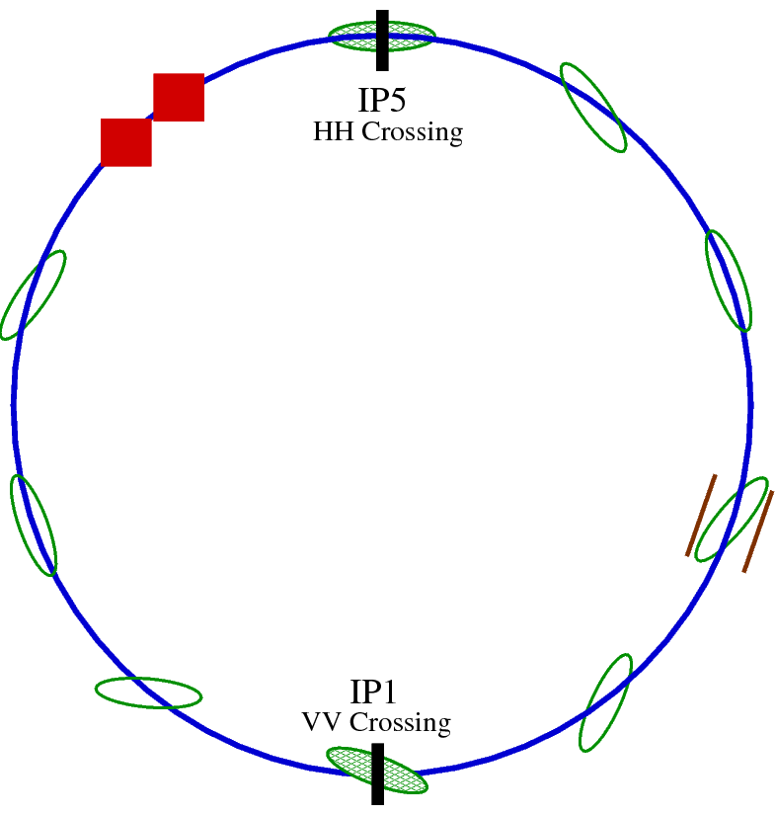
Prototype: IR4 & Cryostat
Potential Locations
420 mm separation
Left IR4
Right IR4
N. Solyak et al, (FNAL)
FPC & HOM Couplers
Tunnel cross-section

Slide 40
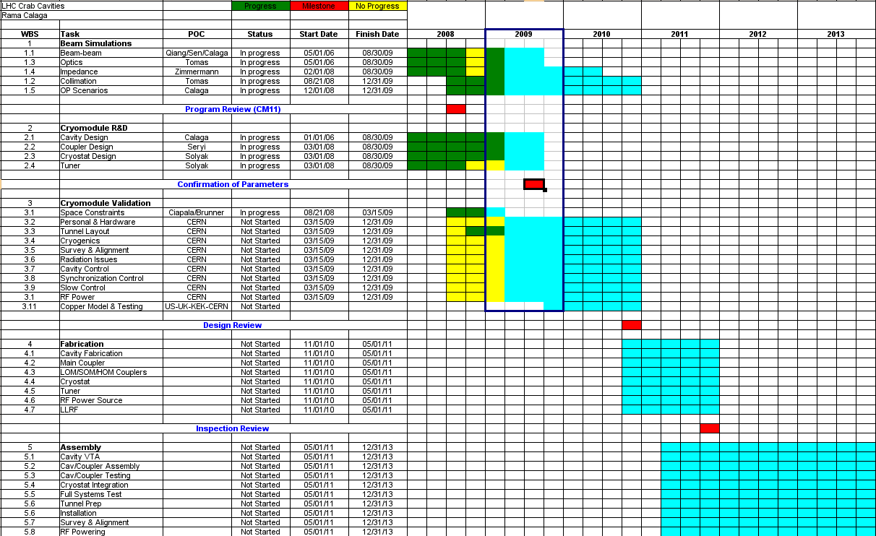
Preliminary Prototype Schedule
Critical Reviews
Fall 2009&10

Slide 41
Global Crab Cavity Contributions
US-LARP
    FY09 funding is good and expected to ramp up in the following years
    focus on cavity/coupler; mostly studies, little hardware!? (except through SBIRs)
UK/CERN
    FP7 Budget sufficient for (670 k€ for 3 yrs, 1.5 FTE/yr):
        Cavity/coupler studies, LLRF, warm model & testing (UK)
        Beam simulations, optics and installation issues (CERN)
    Perhaps an increase in the following yrs., experimental contributions (?)
KEK
    Cavity/coupler simulations based on super KEK-B type structure
    Top level CERN-KEK agreement, funding request & approval by Japanese
    government could allow major contributions
SBIRs (US-DOE)
    AES-BNL/FNAL/LBL/SLAC (cavity, couplers, cryostat, tuner); waiting for SBIR approval(s)
Other Collaborators
    Tsinghua University: Warm models & testing (in collaboration with UK work)
    Jlab: Very interested. Some activity ongoing on rod type compact structures

Slide 42
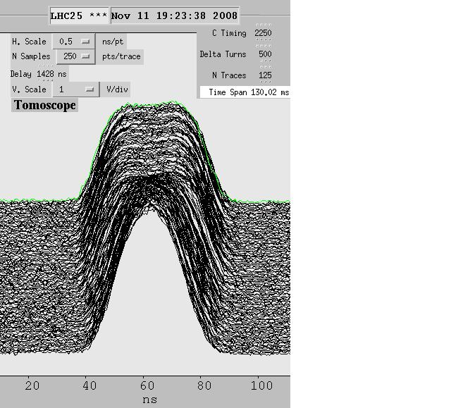
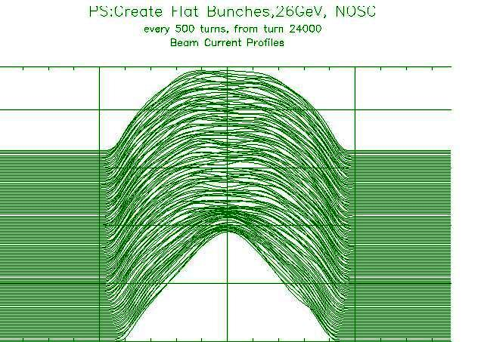
“large Piwinski angle” (LPA)
generation & stability of 50-ns long flat intense bunches
R. Garoby
CARE-HHH
BEAM’07
 | If SPS can accelerate 6×10¹¹ p/b (ε_{L}~0.7 eVs) | If SPS cannot accelerate 6×10¹¹ p/b (ε_{L}~0.7 eVs)
“Best” choice | Generate beam in PS2 at capture [PS2/1] | Slip stacking at high energy [SPS/4] ?
“Alternative” choice | Generate beam in PS2 by merging [PS2/2] | ?
Other (new) ideas | ? | ?
many questions, SPS may be bottleneck!
studies of
flat-bunch
generation
in the CERN PS,
C. Bhat (FNAL),
2008
HHH-LARP
collaboration
Experimental Data
ESME Simulation
95 msec
h=21+42
35 msec
h=21

Slide 43

low emittance (LE) schemes
parameter | symbol | LE 1 | LE 2
transverse emittance | ε [μm] | 1.0 | 2.6
protons per bunch | N_{b} [10¹¹] | 1.7 | 2.36
beam current | I [A] | 0.86 | 1.19
beta* at IP1&5 | β∗ [m] | 0.1 | 0.15
full crossing angle | θ_{c} [μrad] | 311 | 322
Piwinski parameter | φ=θ_{c}σ_{z}/(2*σ_{x}*) | 3.2 | 1.7
geometric reduction |  | 0.30 | 0.51
peak luminosity | L [10³⁴ cm⁻²s⁻¹] | 16.3 | 13.2
peak events per #ing |  | 309 | 250
initial lumi lifetime | τ_{L} [h] | 2.0 | 2.5
effective luminosity (T_{turnaround}=10 h) | L_{eff} [10³⁴ cm⁻²s⁻¹] | 2.5 | 2.7
 | T_{run,opt} [h] | 6.4 | 8.4
effective luminosity (T_{turnaround}=5 h) | L_{eff} [10³⁴ cm⁻²s⁻¹] | 3.7 | 3.9
 | T_{run,opt} [h] | 4.5 | 5.9
e-c heat SEY=1.4(1.3) | P [W/m] | 1.0 (0.6) | ~1.6 (1.1)
SR heat load 4.6-20 K | P_{SR} [W/m] | 0.25 | 0.35
image current heat | P_{IC} [W/m] | 0.33 | 0.64
gas-s. 100 h (10 h) τ_{b} | P_{gas} [W/m] | 0.06 (0.6) | 0.08 (0.8)
extent luminous region | σ_{l} [cm] | 1.5 | 2.8
trade off
intensity vs. emittance
LE1
LE2
smaller brightness is
easier for injectors, but
it comes together with
higher bunch charge,
higher heat load etc.

Slide 44
some conclusions
nominal LHC is challenging
upgrade of collimation system mandatory
beam parameter sets evolved over past 8 years
several scenarios exist on paper which may reach 10x nominal luminosity with acceptable heat load & pile up; different merits and drawbacks (not in a corner)
if possible, raising beam intensity is preferred over reducing β* (better beam lifetime) ;
but intensity might be limited by collimation!
low-β* schemes call for crab cavities
needed: work on s.c. IR magnets for phase-2 and on complementary measures (crab cavities, LR beam-beam compensation, etc. )

Slide 45
thank you!

Slide 46
appendix:
more details on collimation constraints

Slide 47
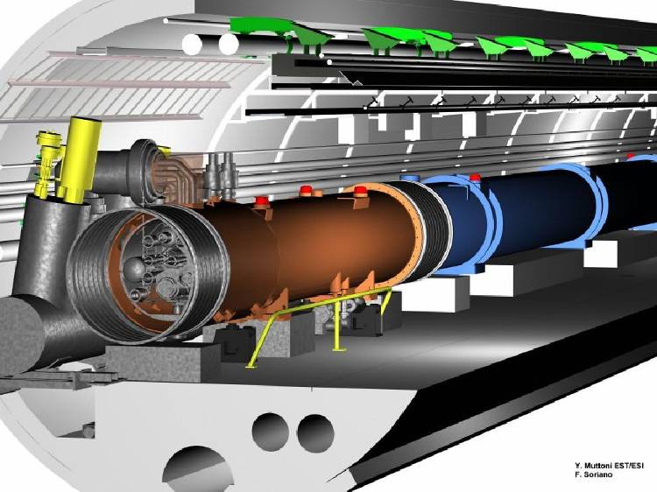
collimation –
quench prevention
Maximum beam loss at 7 TeV: 1% of beam over 10 s 500 kW
Quench limit of
SC LHC magnet:
8.5 W/m
R. Assmann - HHH 2008

Slide 48
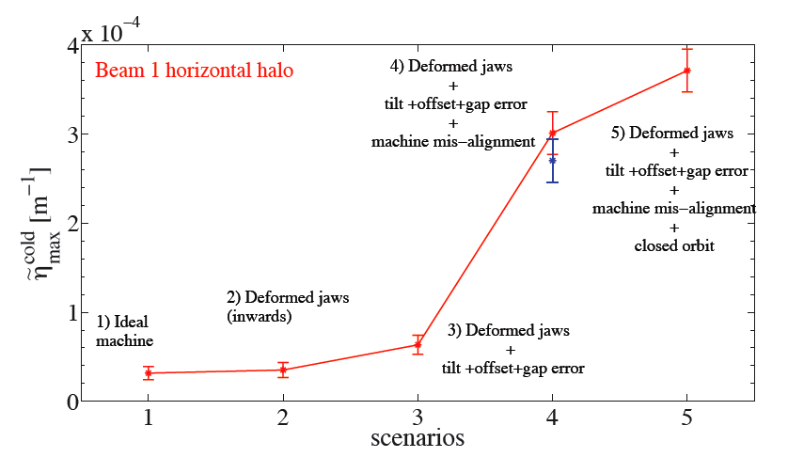
collimation performance
- Cleaning Inefficiency 7 TeV -
worse
Cleaning Inefficiency (~Leakage)
factor
20!
better
PhD C. Bracco
requirement for design quench limit, BLM thresholds and specified loss rates
R. Assmann - HHH 2008

Slide 49
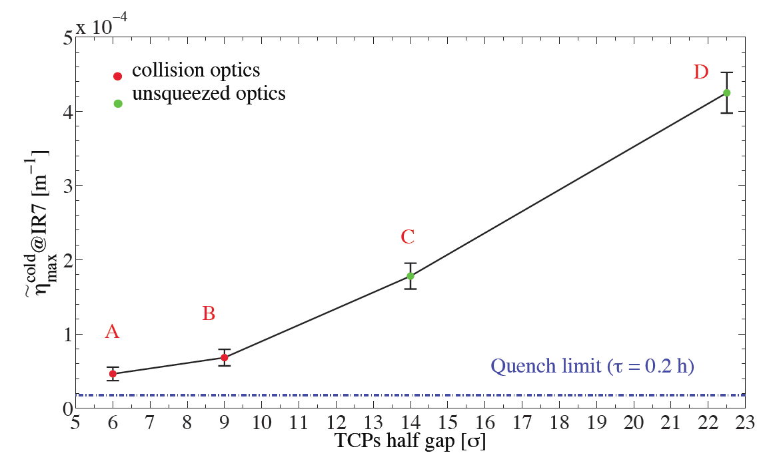
collimation performance II
Larger gaps and lower impedance…
Higher inefficiency,
less cleaning performance
PhD C. Bracco
➔ Phase I IR upgrade will not improve intensity limit from phase I collimation!
Additional room from triplet aperture can only be used after collimation upgrade
R. Assmann - HHH 2008

Slide 50
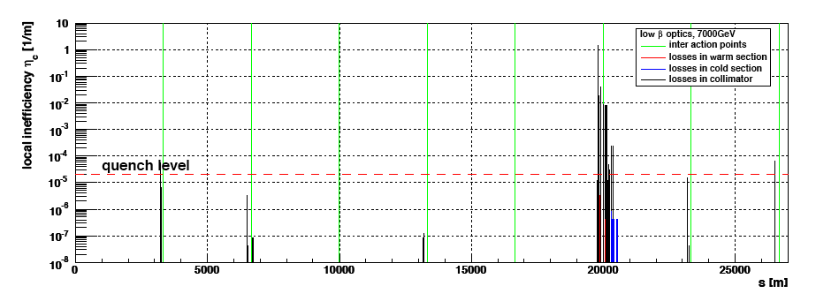
p collimation efficiency w. “phase II” Cu & Cryogenic Collimators
T. Weiler & R. Assmann
99.997 %/m ➔ 99.99992 %/m
inefficiency reduces by factor 30 (good for nominal intensity)
caution: further studies must show feasibility of this proposal
cryogenic collimators will be studied as part of FP7 with GSI in Germany
R. Assmann - HHH 2008

Slide 51
collimation time line
Present view, to be refined in 2009 review:
  February 2009: First phase II project decisions. Design work on phase II TCSM ongoing at LARP and CERN. Work on beam test stand at CERN
  April 2009: Start of FP7 project on collimation ➔ Start of development for cryogenic collimator and (lower priority) LHC crystal collimator
  2009-2010: Laboratory tests on TCSM and cryo collimator prototypes
  Mid 2010: Beam test stand available for robustness tests. Safe beam tests with TCSM and cryogenic collimators (catastrophic failure possible)
  2011: LHC beam tests of TCSM and cryogenic collimators
  2011-2012: Production and installation of phase II collimation upgrade.
  Mid 2012: Readiness for nominal and higher intensities from collimation side
R. Assmann - HHH 2008

